Slide 1
EYFS end of year information evening.

Slide 2

Thank you!

Slide 3
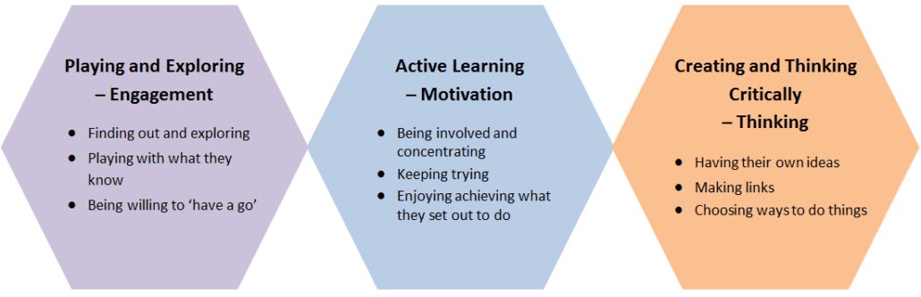
End of year expectations
Aspirational curriculum and the Early Learning Goals.
Completing the EYFS profile and reports.
How we make our assessments and the need for independence.
Characteristic of effective learning!!!!!

Slide 4
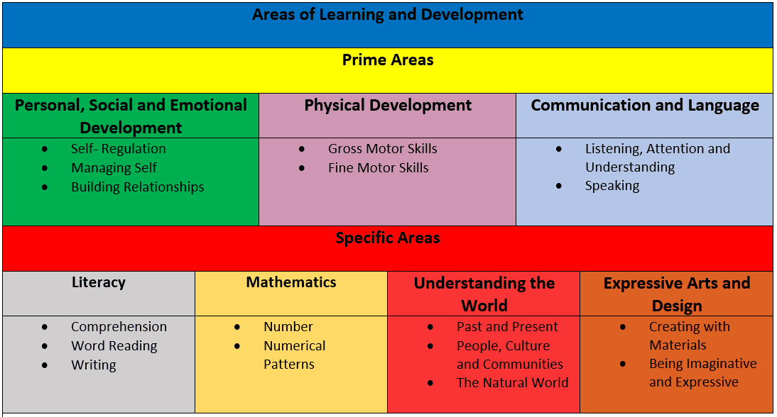
Our curriculum
The prime areas.

Slide 5
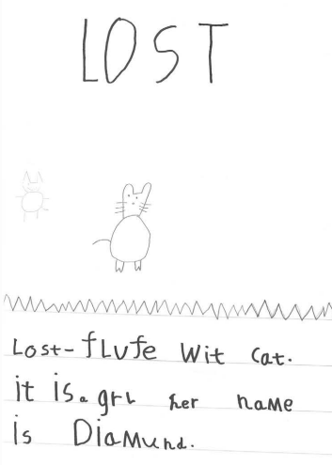
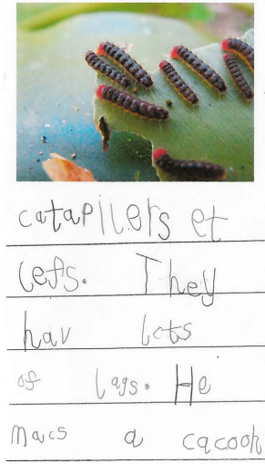
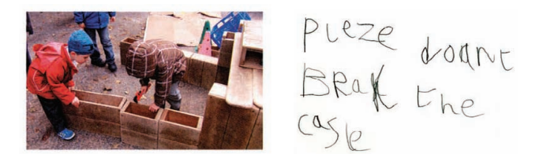
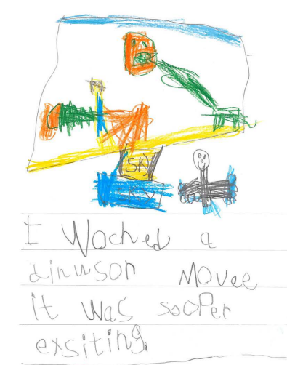
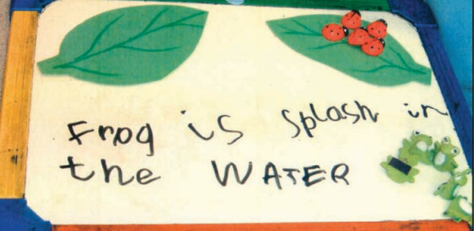
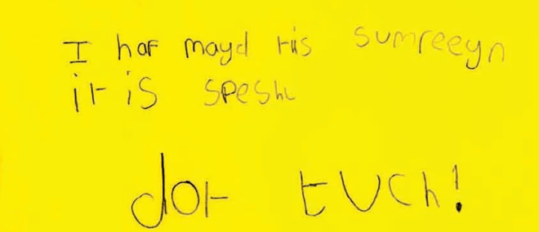
Our curriculum
The Key areas.

Slide 6
Our curriculum
The Specific areas.

Slide 7
Year 1 top tips
Children will be mixed from the current year.
Children will have discovery time at the beginning of the year and gradually reduce over time.
They will have PE twice a week, not once.
Children will receive a Numbots login but oneminute maths is a free app also.
Children will continue on Little Wandle phonics programme and change books on a weekly basis.
Please keep using Sora and the local library to keep reading and write to
someone every now and then to keep skills fresh.

Slide 8
Any questions?

