Slide 1
Welcome to our Year 3 and 4 Curriculum Presentation
Mrs Hutchison, Miss Harris, Mrs Stock and Miss Clarke
Notes:
RH

Slide 2
We are going to briefly talk about:
What a day in the life of Year 3 and 4 looks like
Learning Adventures and Mini Adventures
How we teach English and End of Year Expectations
How we teach Reading and End of Year Expectations
How we teach Maths and End of Year Expectations
– reasoning problems/calculation policy
Home learning
Parent packs
Notes:
RH

Slide 3
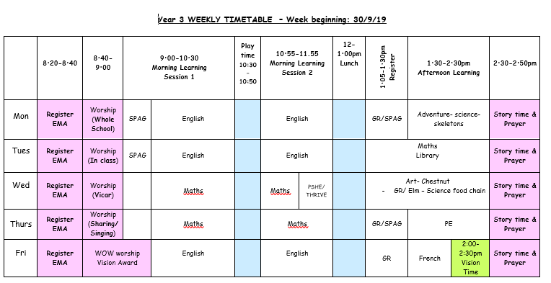
Notes:
RH talk about PPA Trainee Lucy Leadership time NQT time

Slide 4
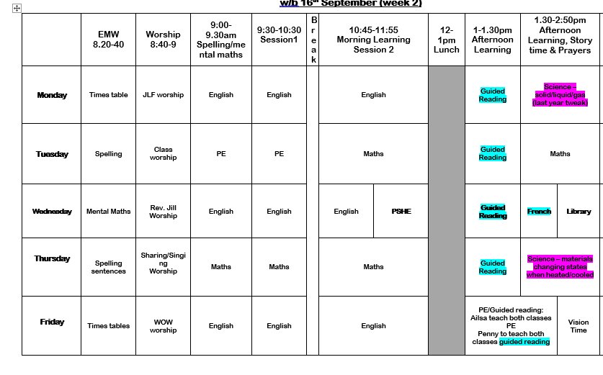
Notes:
RH

Slide 5
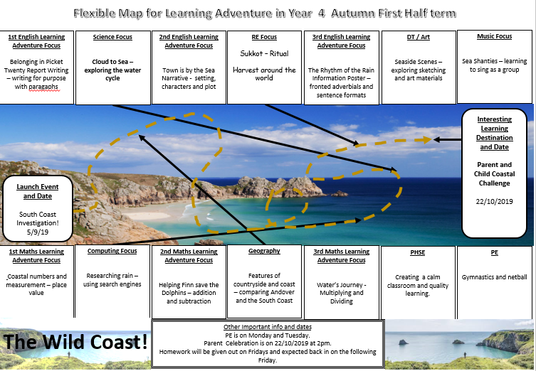
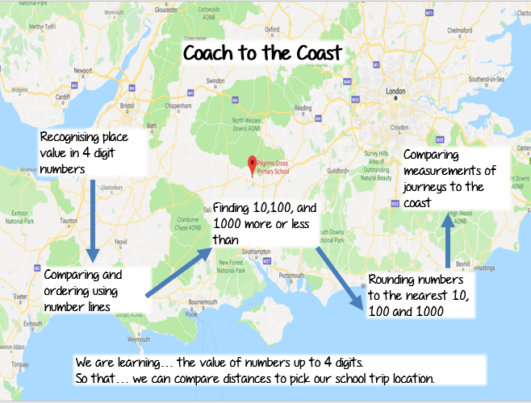
Notes:
AS

Slide 6
How we teach English
Writing Skills
Start with a new Mini Adventure and have a focus for the end.
Whole morning of English
Success Criteria – easy for children to see their steps for the lesson
Learning Walls
Morning tasks (next steps marking, skills or spellings)
Spelling
Learn one spelling rule each week
Some words do not have rules so keep learning and reading!
Home learning- please support your children in learning to spell the year 3 and 4 words correctly. (Please see suggestions in your pack)
Grammar
High expectations for understanding the language of grammar
Teach through writing but some lessons will be stand-alone
Handwriting
Handwriting affects if a pupils reaches Age Related Expectation or not
The letters needs to be formed correctly using cursive and joined
Build it into home learning and spelling work- exercises- Strategies to keep it fun!
Notes:
CH

Slide 7
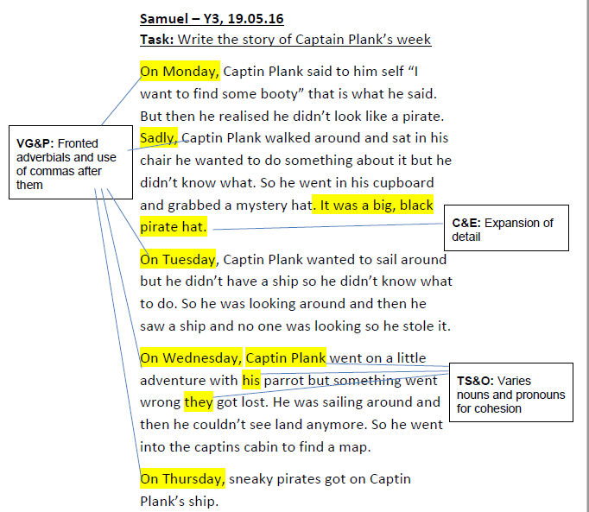
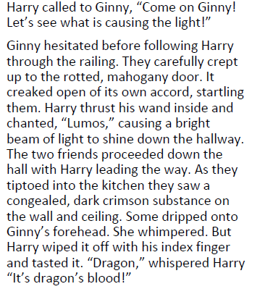
End of Year English Expectations
Notes:
AS / CH

Slide 8
How we teach Reading
Guided reading sessions – 1st week whole class teaching
2nd week carousel of activities
In English sessions – variety of texts
1:1 reading as much as possible
End of day reading
Notes:
BC

Slide 9
End of Year Reading Expectations
Year 3 – Lime is ARE and beyond that is GD
Year 4 – Brown is ARE and beyond that is GD.
The comprehension needs to meet the reading ability too so this is only a rough guide.
Reading at home
Every night for 10 minutes- independent or adult led
Record in diary to be celebrated every Friday
Book bands
Fluency vs. understanding
Poems/Stories from other cultures/traditional tales
REAL reading- online/researching/news
Notes:
BC

Slide 10
How we teach Maths
Introduce new mini adventure and explain what the final task will be.
Whole mornings
Prepare – Trekking – Investigating – Exploring
Learning Walls
Calculation policy
Morning tasks
Notes:
RH

Slide 11
Calculation policy
The school has a calculation policy which clearly demonstrates how the 4 operations are taught in a progressive way as your child moves from year 1 through to year 6. The policy can be found on our school website, in the maths section in curriculum.
Broadening and deepening their understanding rather than moving them on to the next year group/method.
Problem solving
Reasoning
Applying it in different contexts
Open ended exploratory questions
Notes:
RH

Slide 12
Home Learning
The list of spellings
Regular reading – Comprehension questions/ please sign diaries – Bug club
Half termly mini project based on the main Learning Adventure – date will be set when to hand in and then learning can be shared/celebrated with the class.
Times tables Rockstars – 5 minutes a day
Writing for pleasure – please bring it in
Notes:
AS

Slide 13
What's in your pack
Year 3 and 4 spelling list
Year 1 and 2 CEW list
Spelling activity leaflet and suggestions
Handwriting suggestions and handwriting examples
Comprehension Reading Questions
Year 3 and 4 grammar meanings
Maths calculation policy Year 2, Year 3 and Year 4
Notes:
RH thank you and questions but we will be here for the next ….. So come and talk to us

