Slide 1
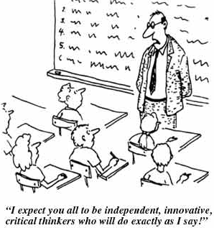
Year 6
Parent’s Information Evening
Reading, Writing, SPAG and Maths
Notes:
Pupils English and reading books out for parents

Slide 2
A typical day in year 6…
  Morning task- Literacy starter or Maths Challenge
  Worship
  Maths Adventure morning or English Adventure morning (Prepare/Trek)
  Playtime
  Maths morning or English morning continued (Investigate and Explore)
  Lunch
  Guided Reading
  Adventure learning
  Arithmetic hit!
  Home time- Home Learning on Wednesday’s/Reading check on Friday’s
  The expectations are even higher!
Notes:
Explain Spag
Show parent friendly KPI statements

Slide 3

Reading
Reading at school
    Guided Reading 5x skills based sessions
    Would you like to help?
Reading at home
    Every night for 10 minutes- independent or adult led
    Record in diary to be celebrated every Friday
Book bands/Free readers
    Fluency vs. understanding
    Literary heritage/Poems/other cultures
Notes:
Questions in packs

Slide 4









Slide 5

Writing and SPAG
Spelling
  Learn the spelling rules each week
  Some words do not have rules so keep learning and reading!
  Keep your list on the fridge!
  Half termly testing on a range of words in a range of ways
  Home learning- Keep it fun!
  Grammar
  High expectations for understanding the language of grammar
  Teach through writing
Handwriting
  Pride in presentation.
  The letters needs to be formed correctly using diagonal and horizontal strokes that are needed to join letters.
  Build it into home learning and spelling work- exercises!
Notes:
Spelling- home learning help
Year 5 grammar language expectations for parents
Handwriting strategies

Slide 6
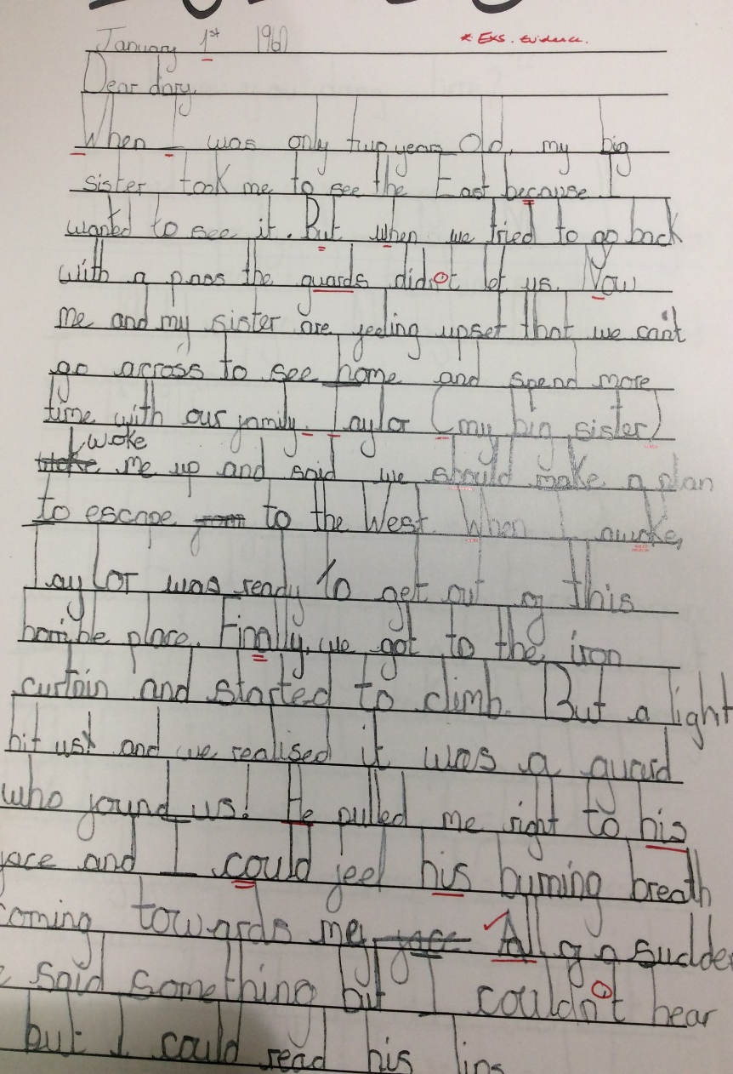
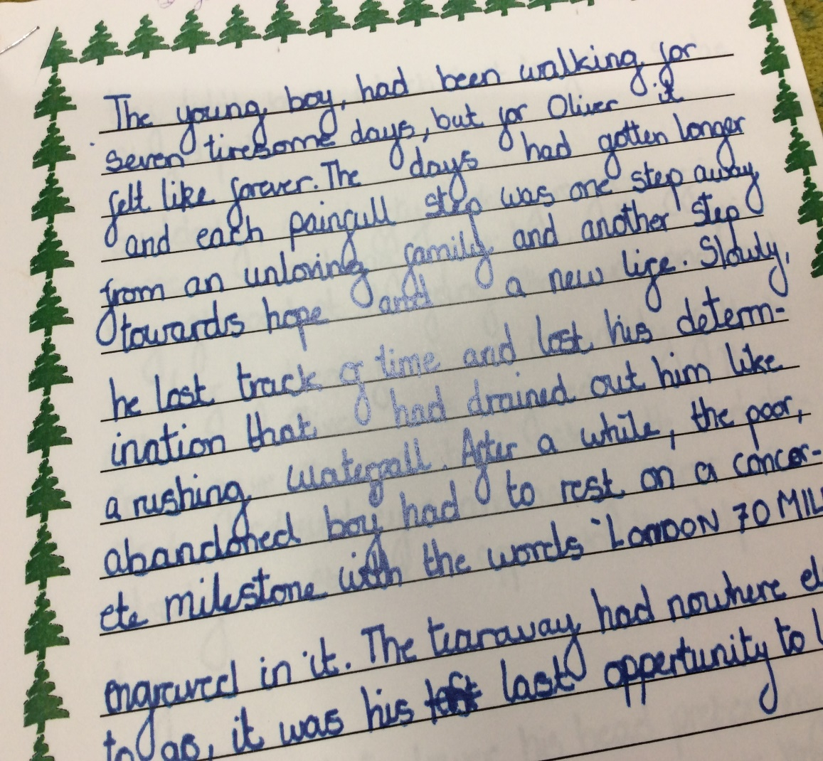
Writing examples…
Notes:
Spelling- home learning help
Year 5 grammar language expectations for parents
Handwriting strategies

Slide 7
Year 6 Maths Expectations…
The pupil can;

Slide 8
Maths examples…

Slide 9
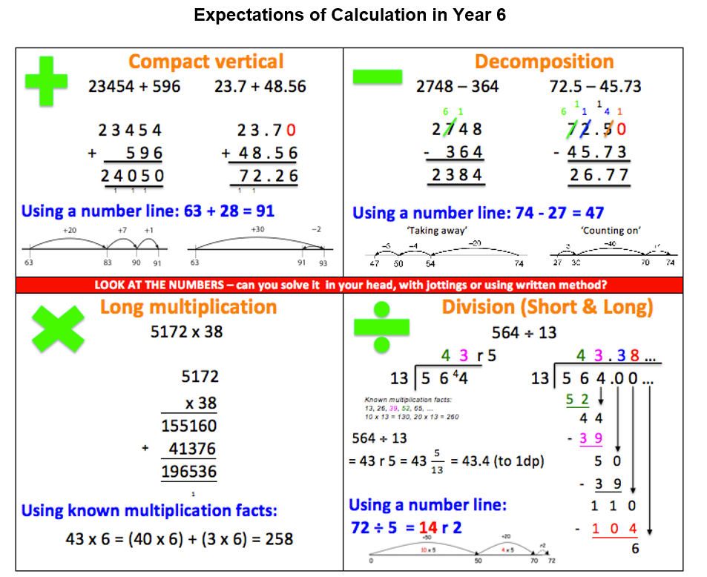

Slide 10

What’s in your pack?
Year 6 Reading, Writing and Maths expectations
Year 6 expectations for spelling and grammar
Year 6 maths expectations
Questions to help with home reading!

Slide 11
SAT’s…
SATs May 2020
  Reading paper
  Spelling test
  Grammar and Vocabulary paper
  Maths Arithmetic and two Reasoning papers
  Arithmetic Paper
  Teacher assessment for writing

