Slide 1
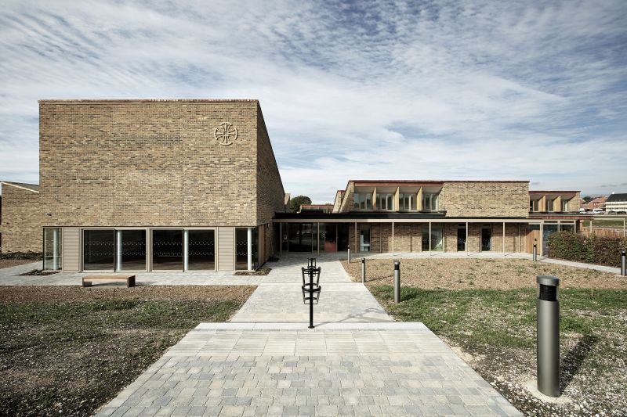
Key Stage 1 Information Evening
Thursday 3rd October– 6pm

Slide 2
The Key Stage 1 Team
Sycamore | Maple | Hazel | Lime
Teacher: Miss Plaw LSA: Mrs Foynes | Teacher: Miss Burgess LSA: Mrs Odling | Teacher: Mrs Carter & Mr Rushton LSA: Mr Stott | Teacher: Miss Longley LSA: Miss Casey

Slide 3
Moving Towards Independence
In Year 1 children are encouraged to develop their independence and become more responsible by…..
Handing in letters/reply slips
Handing in home-learning
Changing their reading book
Changing for PE quickly
Ensuring they have all their things at home time (if all belongings are clearly named this is very helpful)

Slide 4
Structure of Year 1
The curriculum is delivered through exciting learning adventures that incorporate a whole range of subject areas.

Slide 5
Structure of Year 2
The curriculum is delivered through exciting learning adventures that incorporate a whole range of subject areas.

Slide 6
Reading
Reading skills continue to be taught through phonic sessions, individual reading and guided reading.
Book bands
Fluency vs. understanding
Many different texts ranging in ability and themes within a book band
Children are assessed on familiar texts so it is good to read the book more than once
Reading at school
Guided Reading – do not record in reading diaries
Reading with teacher as often as possible
Can you help?
Reading at home
First page of diary provides information
Recommended to read every night for 10 minutes and record in diary (includes Bug Club)
Children can change their book daily - we encourage independence!
Questions to ask and strategies to use

Slide 7
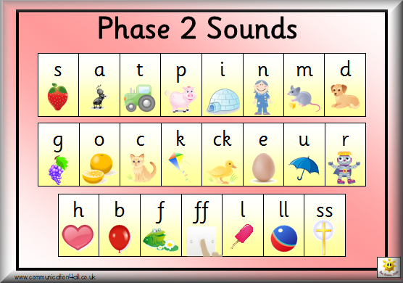
Phonics and End of Year Quizzes
Phonics sessions – building on learning from Year R. The children will then be learning new sounds to support their reading and writing.
In Year One there is a statutory phonic screening check that the children do in June.
This is similar to the phonic assessments that we do throughout the year.
The check is administered as part of the school day and how the children achieved is reported to parents in the annual reports at the end of the year.
SATs
May 2020
Reading paper 1 and 2
Maths paper 1 and 2
Teacher assessment is most important at KS1

Slide 8
Maths

Slide 9
Home Learning Pack & Home Learning
Reading book mark
Phonics sound mat
Handwriting font
Key words to read and spell
Spelling leaflet

Slide 10
Any Questions?
Thank you for coming.

