Slide 1
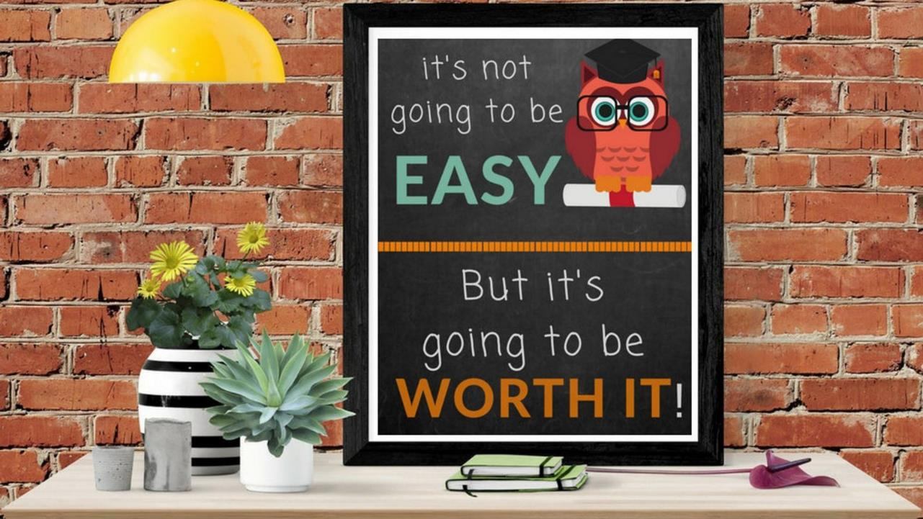

Slide 2
SUMMARY SECTION

Slide 3
The basics

Slide 4
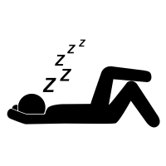
sleep
It is really helpful if you can get your child into a routine of getting enough good quality sleep. The Sleep Foundation suggests that children aged 5 to 12 need 9 to 11 hours sleep a night.

Slide 5
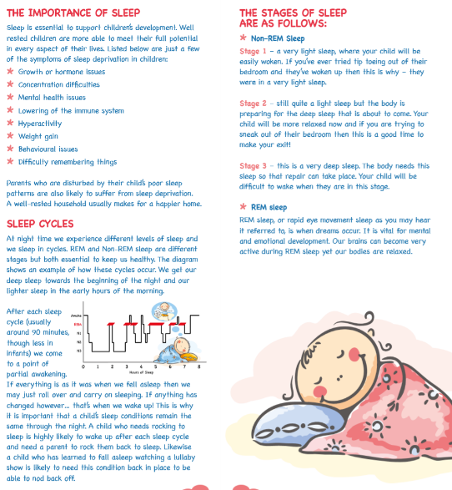
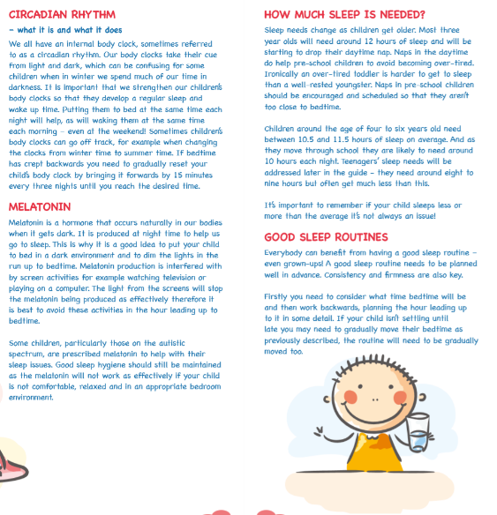
Source: The Goodnight Guide for Children – The Sleep Council

Slide 6
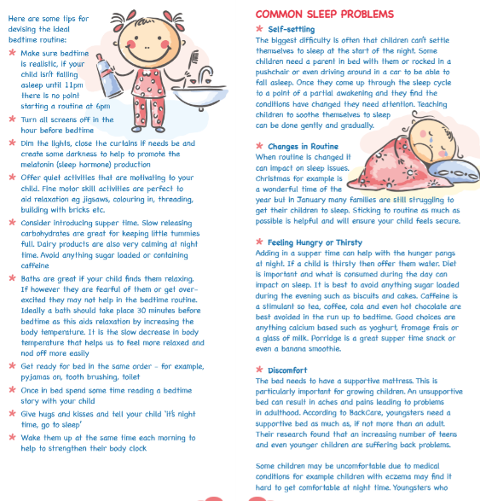
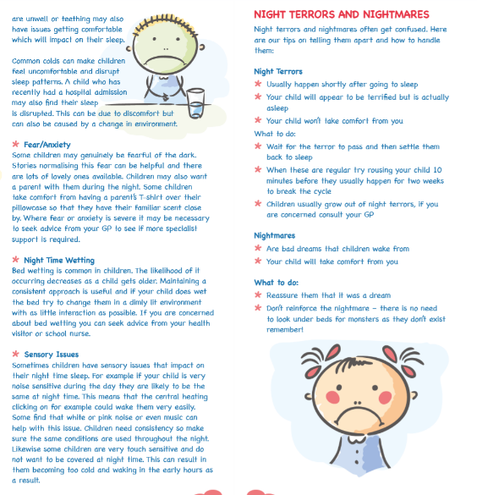
Source: The Goodnight Guide for Children – The Sleep Council

Slide 7
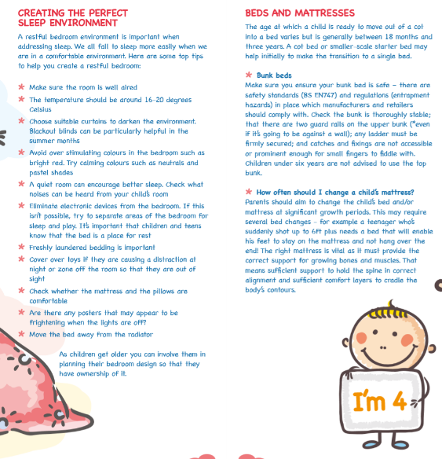
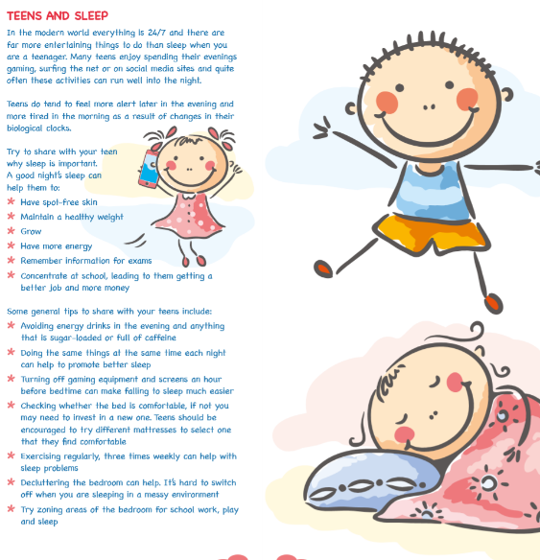
Source: The Goodnight Guide for Children – The Sleep Council

Slide 8
8 Steps to Sound Sleep
Outside play, noise, rough and tumble - A short period where your child can work off some energy through physical play.
Mealtime
TV and quiet play - This should not be a device such as iPad/phone/gaming if there is less than 2 hours till child’s bedtime.
End play and share some quiet time - This may be an opportunity for your child to share any concerns or things ‘on their mind’. Try and keep this time as calm as possible, but if your child tends to choose bedtime as their usual time to try and talk to you, then creating an alternative opportunity to ‘share & catch up’ might alleviate later bedtime difficulties.
Final drink and snack
Bath, teeth, toilet and pyjamas
Story, magazine, comics, collector cards, catalogues - This can be a time to share a story with your child, or your child can do this independently. Alternatively, you could consider a short period sharing a book together and then your child could have 10/15 minutes alone.
Lights out

Slide 9
GoNoodle gets kids moving with short interactive activities.
exercise
Children these days don’t do nearly as much exercise as you did when you were a child. This is a shame – not just for their physical heath, but also for their mental health too. Children should be doing half an hour of really energetic activity every single day.
Obstacle courses provide great regulating sensory experiences.
Encourage your child to carry objects to make the obstacle course. Try to include things that will allow your child to crawl and have different body positions.
Cosmic Kids Yoga includes simple yoga poses which are fun and regulating, and can be completed by you and your child together.
Source: Beacon House (Therapeutic Services & Trauma Team – www.beaconhouse.org.uk
GoNoodle (Movement & Mindfulness) – www.app.gonoodle.com
Cosmic Kids Yoga (Yoga & Relaxation – www.cosmickids.com

Slide 10
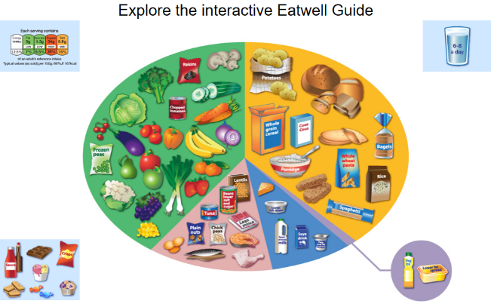
diet
The Eatwell Guide shows how much of what we eat overall should come from each food group to achieve a healthy, balanced diet.
Eating a wide variety of nutritious foods helps mood, attention and learning.
Eating regular meals also helps promote good mood and attention.
Including foods that are rich in fibre are also beneficial.
Nutritional supplements may help some children. This is especially true when the diet is low in any particular nutrients.

Slide 11
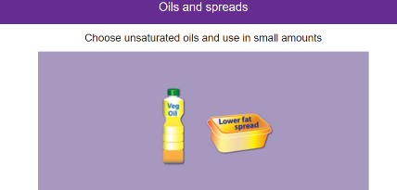
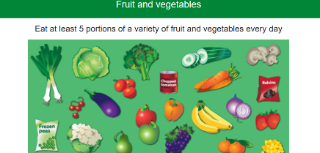
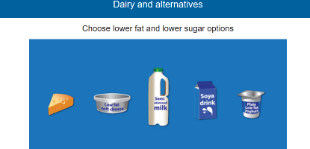
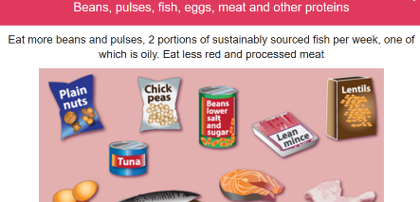
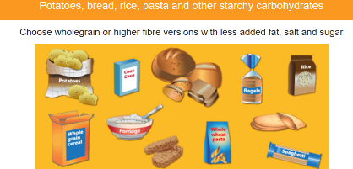
Source: Eatwell Guide - NHS

Slide 12
What is Maslow’s Hierarchy of Needs? Maslow’s Hierarchy of Needs developed by Abraham Maslow argues that humans have different levels of needs. The needs are tiered as displayed in the image. At the base of the pyramid are basic human needs (food, water, clothing, etc.), and at the top is self-actualization (the finding of purpose). Each intermediary level builds upon the level below it. In other words, in order for a child’s safety and security needs to be met, their basic human needs need to first have been met. Once basic human needs are met, then relationship needs should be met, then once relationship needs are met, then achievement needs can be met, and finally once all other needs are met, then the need for self-actualization can be met.

Slide 13
Positive parenting

Slide 14
Predictability
When the world is unpredictable and confusing there is a lot of uncertainty which can lead to anxiety.
Many children have a need to control activity and interaction around them. To help deal with this insecurity and anxiety, we have to decrease the uncertainty in their lives.
Boundaries
Structure & Routines

Slide 15
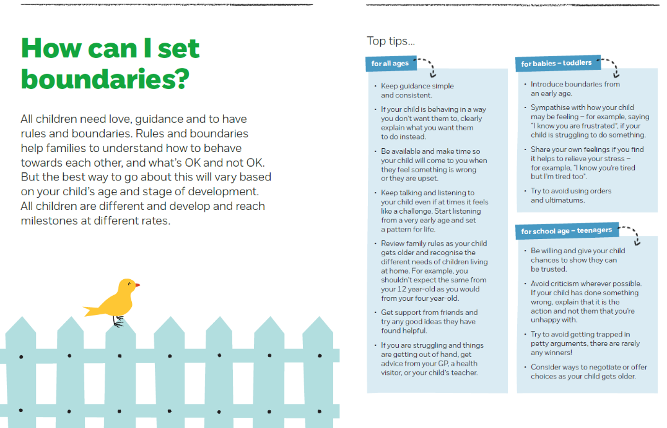
Source: NSPCC Need-to-know-guides – Positive Parenting

Slide 16
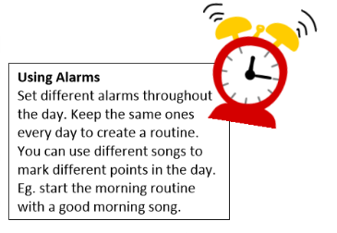
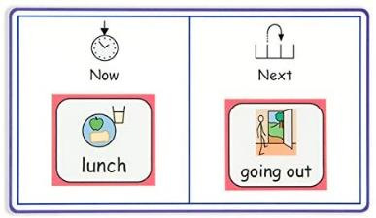
Structure & Routine
Build structure into your daily routine: The more structured and predictable the daily routine is, the less uncertainty there is for the child.
Using a Visual Schedule
If possible, provide visual timetables (pictures or text) so children can see what is coming up next and what they are doing now. This gives order to their day. These visuals provide a path to follow. It lets them know what to expect and when to expect it. This alone can reduce anxiety.

Slide 17
Transitioning between Tasks
Some children can have difficulty switching their brain activity between different tasks.
They do much better if they have warnings or reminders when one activity is ending and another is beginning, especially if the current activity is a favourite activity.
To ease transition difficulties try to ensure that the child always knows what will be coming up next, e.g. watch TV, then bath.
Use timers if it helps.
This way their brain is prepared for what is coming up next, and the reminders help bridge the transition. This is particularly useful for limiting time spent on devices – there are some apps available that allow you to control this from your phone, e.g. screen time.

Slide 18
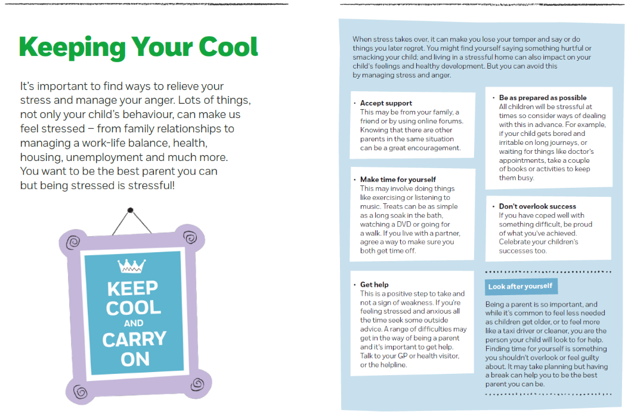
Source: NSPCC Need-to-know-guides – Positive Parenting

Slide 19
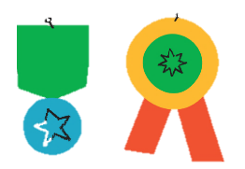
Rewards & consequences
Children need to learn that being good feels good. They do this by having lots of chances to do well and getting rewarded for it. You can help with this by giving rewards for the behaviours that you want to see in your children.

Slide 20
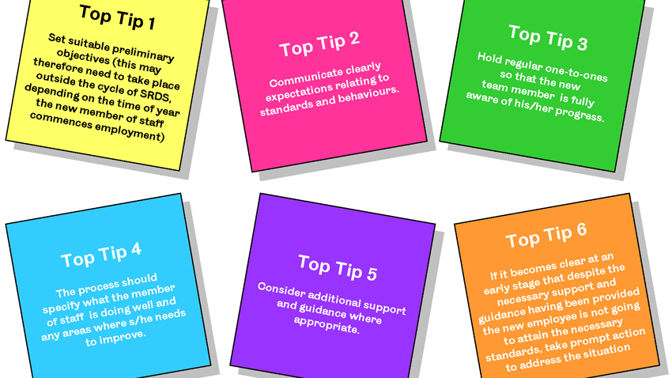
Give rewards for behaviours that you want to see more of
Give the reward as soon as possible
Get the behaviour before you give the reward
Give your child lots of clear, specific praise at the same time as giving the reward
Make the reward the right size for the behaviour
Stick to your promises

Slide 21
Star Charts
Star charts work particularly well for children aged 4 – 12 years old
Choose the behaviour that you want to see more of
Choose the reward
Choose how many stars your child must earn before they get the reward
Make sure the first few stars come particularly fast
Make sure that what you are asking is manageable
Get your child involved
Never mark up failures on a start chart
Leave days and dates off the chart
Source: Sam Cartwright-Hatton – Coping with an Anxious or Depressed Child: A Guide for Parents & Carers

Slide 22
Some Ideas for Simple Rewards…
Getting to stay up half an hour late
Painting your child’s nails
Watching a favourite cartoon
Having a friend round to stay over
Getting to choose what sort of take-away to order
A small toy (e.g. something from a pound shop
Half an hour on the PlayStation.
A trip to the park
A magazine

Slide 23
Assault cycle
One recognised method of identifying actions that can lead to challenging behaviours is the ‘Assault Cycle’. Learning and understanding the phases of the curve will help you to identify the patterns of escalating behaviour and assist your child to respond appropriately. As the child becomes increasing stressed about a perceived threat, the intensity of their emotions escalates. Their reaction and response to the threat is cyclical in nature, each one associated with behavioural, physical and psychological responses.

Slide 24
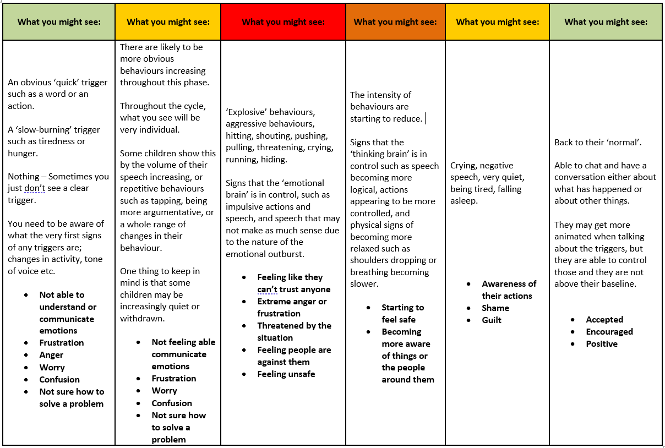
Words in bold are feelings the child might be feeling during each phase

Slide 25
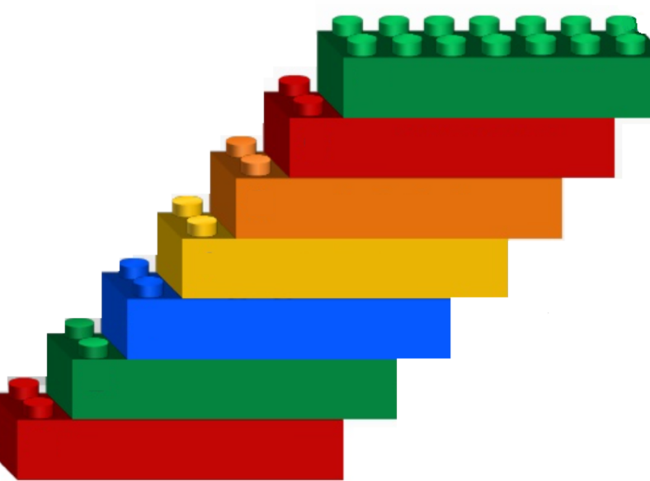
The 7 Confident Thoughts
Happy, confident
children are those who
have a feeling that the
world is safe, that they
can cope with most things, that they have some control over their lives and that people are generally nice.
‘ The 7 Confident Thoughts’ are the building blocks of self-assurance and self-confidence. People who can think in this way will be more ready to cope with and manage any changes that may arise.
The world is pretty safe
I can cope with most things
Bad things don’t happen often
Bad things don’t often pop up out of the blue
Children who feel that the
world is fraught with danger or that they cannot cope (even if they actually can) are prone to anxiety and other mental health problems. So they need to start developing the belief that the world is safe and that they can cope with whatever life throws at them. In order to do this we should teach them about how our thoughts have a huge impact on our feelings and behaviours.
I have some control in my life
People are generally pretty nice
Other people respect me
Source: Sam Cartwright-Hatton – Coping with an Anxious or Depressed Child: A Guide for Parents & Carers

Slide 26
Brain development

Slide 27
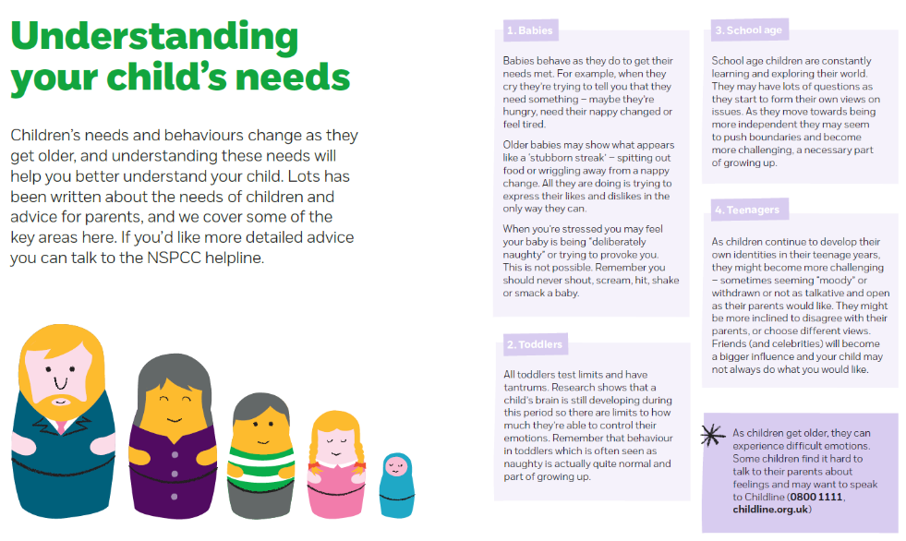
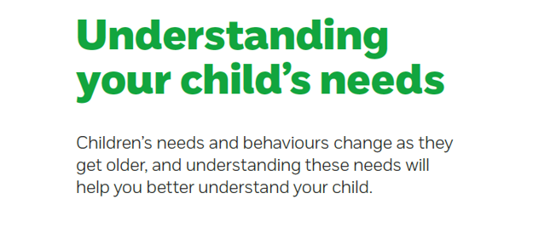
Dr. Sam Cartwright-Hatton
Source: NSPCC Need-to-know-guides – Positive Parenting

Slide 28
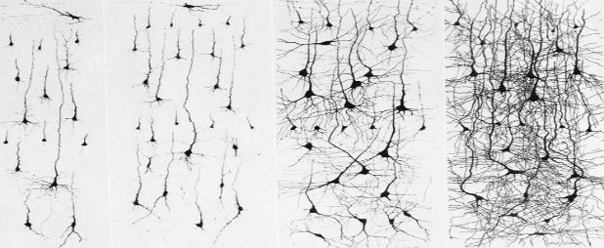
Growing a Brain
New-born 3 months 15 months 2 years
“What happens when we get angry?”
Source: LearnStorm Growth Mindset: The Truth About Your Brain – Khan Academy

Slide 29
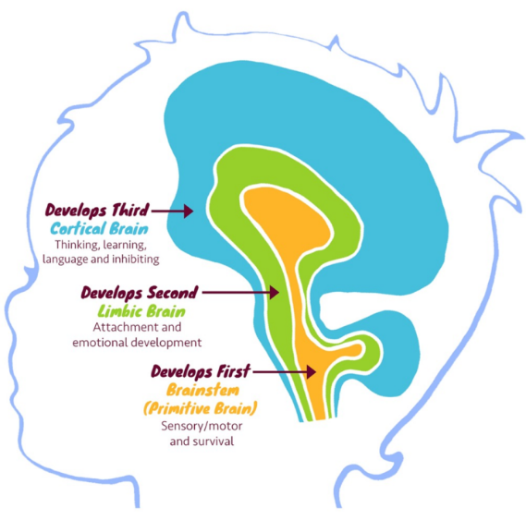
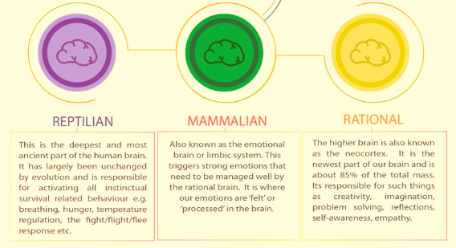
Source: Dr Daniel Siegel presenting a Hand Model of the Brain

Slide 30
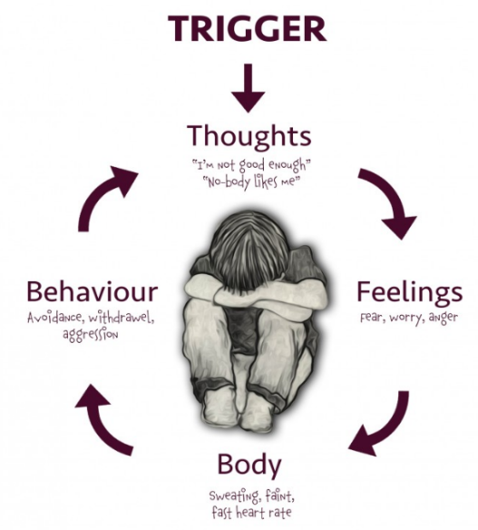
Source: Beacon House (Therapeutic Services & Trauma Team – www.beaconhouse.org.uk

Slide 31
Play

Slide 32
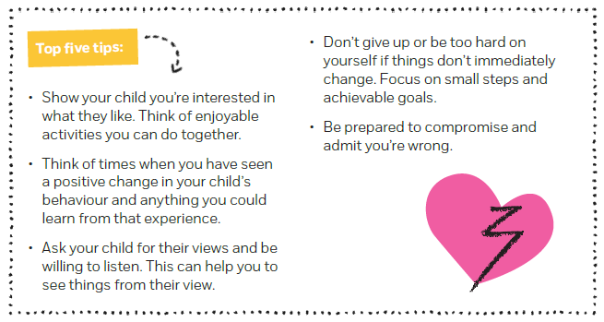
play
Click link for more play activities…
Children need the freedom to explore and play as their development is influenced through the exploration, thinking, problem-solving and language expression which occurs during play.
Play nourishes every aspect of children’s development – it forms the foundation of intellectual, social, physical, and emotional skills. These skills support children in being ready for school and their future lives.
Additional Activities
Click link for parent/carer guide to play…
Source: NSPCC Need-to-know-guides – Positive Parenting

Slide 33
Developmental Play Ideas

Slide 34
Face painting using feathers
Hand massage
Mirrors (to make eye contact) or looking at one another through glass
Dark tent with sensory objects
Blanket wrapping
Special diary of things they’ve done
Sensory bottles (lava lamps etc.)
Inviting a friend to a special party
Making their own treasure box
Badge making
Bubbles
Temporary tattoos and nail painting (with permission)
Invisible string which will always link you together
Making a transitional object
Making jewellery
“Relax Kids” books and CDs of meditation
Drawing around the child or around their hands
Peer massage on each other’s back (children need to ask permission before they touch another)
Memory boxes
Looking after special objects such as a bear or a doll
Worry dolls (Silly Billy by Anthony Browne) or worry bags (A Huge Bag of Worries by Virginia Ironside)
Feelings tree
Nurture

Slide 35
Sharing stories and walking through a story together
Cooking, possibly with no recipe
Gardening
Construction such as Lego with no instructions.
Taking things apart e.g. old electrical items
Painting a picture together
Messy play e.g. gloop, shaving foam, flour, glitter, spaghetti hoops, jelly, snow (cornflour and conditioner), moon sand, sand mousse (sand, water and bubble bath) mud pies, shredded paper, saucer of milk with drops of food colouring then add washing up liquid.
Using puppets
Sand trays
Small world play
The Shape Game, doodles, consequences, modelling clay then passing it on for next person to continue.
Feely bag
Treasure chest.
Building dens
Dressing up box
Belonging

Slide 36
Using musical instruments to act out feelings
Construction with a challenge in mind e.g. make something with four wheels or a tall tower
Categorising and sorting e.g. find different things that are the same colour, different ways to get into groups
Treasure hunt/ scavenger hunt
Sand tray – relating it to feelings
Talking about characters from books and exploring their emotional landscape.
Dancing/painting to different types of music
Puppet scenarios to address issues
Water play with problem solving e.g. how can I move the water/fill the bucket?
Board games or strategy games such as chess where the children have to think ahead
Computer games with decisions to make (Scratch), CBeebies games such as build your own park in Bob the Builder land, Simple City.
Problem Solving

Slide 37
Misfits (you draw the head, fold the paper, pass it on and the next person draws the next body part)
Box game (joining dots, taking turns)
Using blindfolds to get over different obstacles
Sitting back to back and describing something for the other child to draw
Simon Says
Mirroring/shadowing activities
Tasting things with blindfolds on and discussing preferences
Draw around a child and then stick post it notes when they achieve something
Den building
DT projects as a team
Roleplay/hot seating
Heroes – why are these famous people like heroes?
Junk modelling monsters – what qualities do they have?
Post-it note game
What if…?
Teamwork

Slide 38
Therapeutic Play Ideas

Slide 39
Taking care of hurts with lotion and/or sticking plasters
Footprints or handprints with paint; requires adult to wash them later
Help the child to relax on a bean bag and become soft and floppy. Wiggle body parts to see if they’re relaxed
Roll the child up tight in a blanket
Place heavy pillow on child’s stomach; the child has to move it only using his stomach muscles
Draw pictures, letters or number on each others backs
Face packs
Feeding favourite foods with blindfolds; guess what you are eating
Group massage in a row or circle
Fan after an activity or use cool flannel
Doughnut challenge; adult or peer places a doughnut over his finger. Child has to make as many bites into the doughnut as he can without making it fall off
Arrange feathers in a child’s hair; the child has to copy the same pattern in the adult’s hair
Polish fingernails
Manicure/pedicure after soaking feet/hands in warm soapy water
Arrange/comb hair
Try on hats, selecting them for each other
Describe the other person’s likes and preferences
Read each others palms
Tell me what you will be like when you are an adult
Using face paints make each other look as young as you can then have a “regression” party where you pretend to be babies or 5 year olds. Do appropriate play from those age groups
Guide a blindfolded peer around an easy obstacle course
Nurture
“The purpose of nurturing activities is to reinforce the message that the child is worthy of care and that adults will provide care without the child having to ask. Nurturing activities help to calm and regulate an anxious child and enhance feelings of self-worth.”

Slide 40
Slow motion ‘Follow The Leader’
Hand-clapping games
Eyes closed: guess where I touched your face with a feather
Mirroring: face each other and copy the other’s facial expression or facial and body movements. For a very active child you can use slow motion. Take turns being the leader
Stick a cotton ball on your nose with lotion; ask the child to blow it off
Row, row, row your boat. Add the child’s name at the end, e.g. Jack is such a dream
Create a special handshake – high 5, wiggle fingers, bump knuckles and use in the group
Hide and seek; the adults make appreciative comments about the children as they look for them
Divide into 2 teams. Have a cotton ball or crushed newspaper balls “snow fight”. Players may set up a shield e.g. a pillow behind which they hide. Add more structure for over-active children
Do the Conga to music, copying the actions of the leader
Make life-size body/head tracings and fill in as a collage or with positive comments from the group
Winking games: if the leader winks her left eye the others take one step to the left
Do a job/walk somewhere, keeping a beach ball between you
2 person bean bag throwing/juggling
Peanut butter and jelly (or fish and chips). Say fish and get the child to say chips in the same way, varying tone and loudness
Foil prints: the child makes a foil impression of a part of his body and the others have to guess which part it is
Teach the child something he doesn’t know
Engagement
“The purpose of engaging activities is to connect with the child in a playful, positive way, to focus intently on the child, and to encourage him/her to enjoy new experiences. At all times it is important to attend to the level of the child’s arousal and modulate it when needed.”

Slide 41
Place a beanbag on your head. The child has to catch it when you tilt your head. Then swap over
Cotton ball blow: blow a cotton ball across a blanket to someone else
Measure the children’s heights on one of the walls
Toilet paper bust-out: wrap the child’s legs, arms or whole body with toilet paper. On a signal the child breaks out of the wrapping
Activities that cycle from fast to slow where the children have to wait for a signal e.g. When the adult shouts “dinosaur” the children have to run on the spot etc.
The group have to move together underneath a turtle shell (could be a piece of sugar paper). They have to follow adult instructions
Cotton ball hockey or football in 2 teams
Pop bubbles with your head/your feet/your shoulders only
The group tries to keep a bubble in the air for as long as possible
Red light/green light: ask the children to do something e.g. run on the spot, do star jumps. With your back to the children ask them to start when you say green light. See if you can catch anyone moving when you have said red light
Three-legged walk: obstacles can be added to make this more challenging
The Hokey Cokey
Zoom-erk: Sitting in a circle, the word “zoom” is passed around the circle quickly. When one person stops the action by saying “erk”, the “zoom” reverses and is sent back the way it came
Structure
“The purpose of structuring activities is to organise and regulate the child’s experience. The adult sets limits, defines body boundaries, keeps the child safe, and helps to complete the sequence of activities.”

Slide 42
Paper punch: hold a piece of newspaper stretched out and invite the child to punch through it. Praise his strength. Increase the challenge by adding additional layers of paper
Balance a pillow/cushion on your head as you move around the room. How long can you balance it for? Increase the challenge by adding pillows
Pop bubbles as quickly as possible using only one part of the body
Keep a balloon in the air
Balance on a stack of pillows
Walk around balancing a beanbag on your head
Jump to see how high you can reach and touch the wall
Eat watermelon and then see who can spit the seeds the furthest or see how many the group can get into a container
The group all hold hands in a circle and then tangle themselves up. Children have to give instructions to help them become untangled without breaking hands
Have a water pistol fight or water pistol shooting contest with a target
Feather blow: waft a feather from one end of the room to the other using a piece of card. Who can reach the other side first?
Challenge
“The purpose of challenging activities is to encourage the child to take age-appropriate risks in order to foster feelings of competence and mastery. These activities are mostly done cooperatively with the adults. Challenging activities also help the children to accept structure, engagement and nurture that they may resist in more direct forms.”

Slide 43
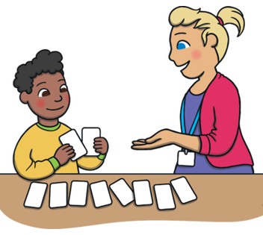
Special time
Try to do special time every day.
Ask your child what they want to do for the ten minutes. Let them choose anything, within reason.
During the ten minutes, give the child your undivided attention.
Turn the TV off, ignore the phone, don’t try to do anything else (e.g. cook the dinner, do the ironing) at the same time.
Have a nice time with your child and use this time to give your child lots of praise.
Give your child lots of affection during these ten minutes – give them hugs and kisses if they like that. If they don’t like hugs and kisses, at least try to show some physical affection – put an arm around their shoulder or touch them on the arm a few times.
Let the child be in charge during these ten minutes. If they want to change the rules of the game that you are playing, that is fine. If they act silly or show off, let it pass. During these ten minutes, it is all about having a relaxed time. Don’t criticise your child unless they actually do something dangerous.
Don’t use this time to teach your child – there are plenty of other times for learning. These ten minutes are just about enjoying your time together.
Try not to ask too many questions during these ten minutes. Asking questions stops your child’s mind from relaxing and going with the flow. Questions are fine at any other time, but not in this special ten minutes.
Giving your child ten minutes of your undivided attention every day
Source: Sam Cartwright-Hatton – Coping with an Anxious or Depressed Child: A Guide for Parents & Carers

Slide 44
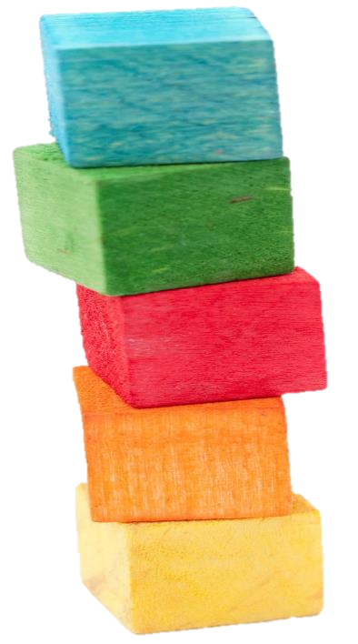
Make it really clear what you are giving the praise for (e.g. “Thank you for listening to my instruction”
Praise
Sound really positive when giving praise
Praise nurtures your child's confidence and sense of self. By using praise, you're showing your child how to think and talk positively about themselves. You're helping your child learn how to recognise when they do well and feel proud of themselves.
Don’t follow praise with criticism (e.g. “Well done for tidying your room, why can’t you do that every day?”
Give praise when you see a behaviour you like
Give praise straight after the behaviour you liked!

Slide 45
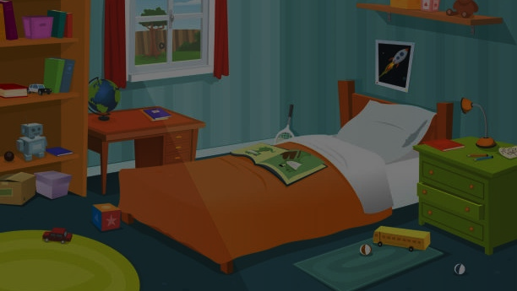
“You are putting your toys away really nicely!”
“I really like it when you share your toys with Sam!”
“I’m really proud of you for going to school today!”
“Good boy for doing as you were asked first time”
“Wow, what a wonderful job you’ve done on your homework!”
“Thank you for coming in on time!”
“Well done for going upstairs in the dark!”
Source: Sam Cartwright-Hatton – Coping with an Anxious or Depressed Child: A Guide for Parents & Carers

Slide 46
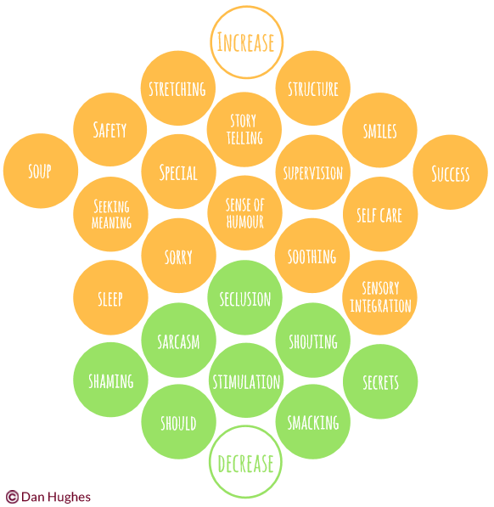
Being playful can be achieved by keeping the tone light and upbeat, smiling, ruffling a child’s hair when walking past, playing hide’n’seek when they get in from school, or giving a quick hug for no specific reason. Praise can be positive when it is kept specific, short, low key or done with pizzazz – a pretend fanfare, whistle, or victory dance when they get their spellings right or remember to pick up their toys.
Adults should show the child that they love or like them especially when the child misbehaves. This helps to move the child from the damaging effects of shame to the healthy development of guilt. If you do lose your temper, apologise and reconnect with the child quickly afterwards.
Accepting the child for who they are, not what they achieve is important for children. This does not mean that their behaviour has to be accepted! Remain calm and say something like, ‘I can see you are upset about this. That doesn’t mean you are allowed to hurt people.’
Being curious and wondering aloud about why the child is behaving in a certain way can be helpful. ‘I wonder why you are shouting so much today’, ‘Isn’t it amazing that you just remembered that (particular event) today,’ can help a child reflect on their actions and is usually more effective in raising awareness than asking directly what’s wrong. A child who has ‘switched off’ their feelings may not know what is bothering them, they may say something trivial, or withhold the information through lack of trust. Being curious, or making an educated guess (not assuming you know for sure), ‘I’m thinking you might be worried about the spelling gala on Friday’ can be an excellent way to open a discussion, in which you can listen attentively and not interrupt.
Empathy is the most important quality we can have when working with children. To understand the child’s needs we must put ourselves into the child’s shoes. It is important not only to feel empathy but to convey it to the child, ‘I can see that this is hard for you’, ‘Your knee is really red, I bet it hurts.’ Empathy allows the child to feel their feelings, not suppress them. It encourages the release of grief and rage which, if buried, can continue to cause emotional and behavioural problems. Adults should empathise with the child before putting disciplinary measures in place and while employing those measures (e.g., consequences). The adult must be genuinely empathic, not flippant or sarcastic
Source: Scottish Attachment in Action (Dr Dan Hughes) – www.saia.org.uk

Slide 47
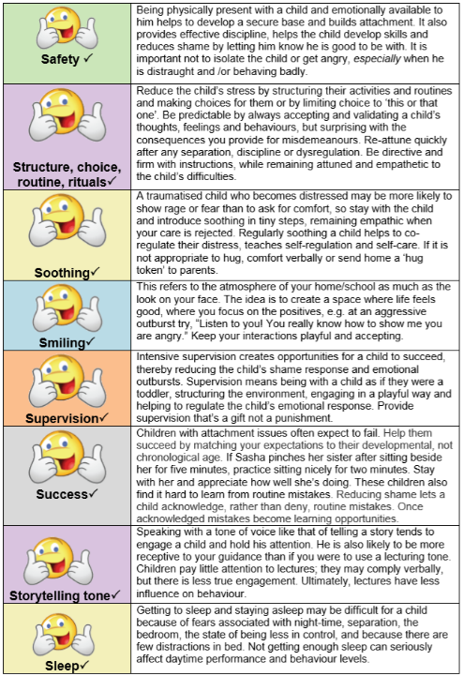
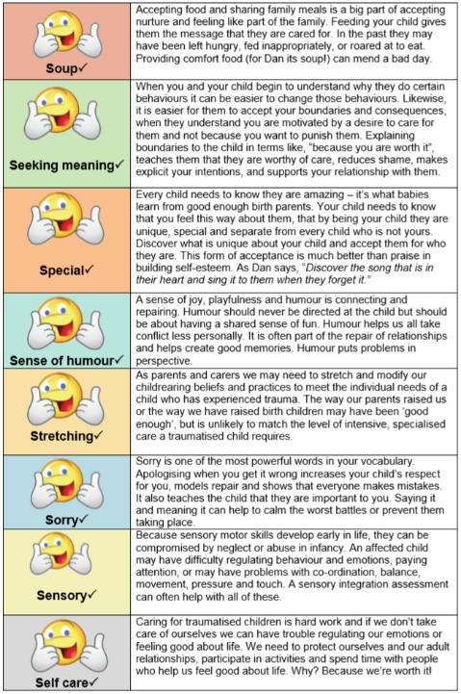
Source: Scottish Attachment in Action (Dr Dan Hughes) – www.saia.org.uk

Slide 48
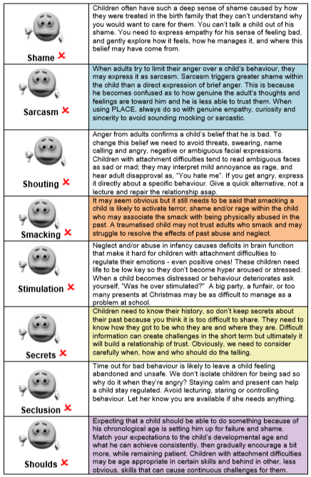
Source: Scottish Attachment in Action (Dr Dan Hughes) – www.saia.org.uk

Slide 49
change

Slide 50
Managing change
Be kind to yourselves and each other
Keep lines of communication open
Reach out and ask for help
Change can be good or bad. It depends on the person and the situation.
Good or bad change requires an adjustment of some kind; this takes energy. If the demands are too great, it can drain you and create stress. Unmanaged stress can cause physical and emotional problems.
You may not be able to control the change itself. So, the key to coping with change is to gain control of your response to it as much as possible. That’s when adjusting your attitude toward change can help.

Slide 51
How to Deal With Unexpected Change Acknowledge that change is the new normal Explore your feelings about the change Prepare for it Rely on your support system or create one Give yourself grace as you move forward

Slide 52
How to Cope when Things Feel Out of Your Control Imagine what a role model or admired friend would do in the same situation. Write down your thoughts. Stress can make us think negative thoughts about ourselves. Talk to others about how you're feeling.

Slide 53
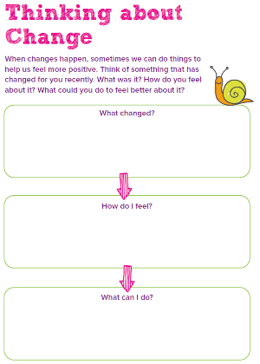
Helping your child to manage change through COVID-19
Source: Banardos Back to School Booklet – www.barnardos.org.uk

Slide 54
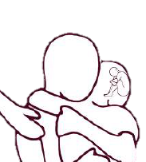
transition
Children may be feeling frightened by the end and the start of the school year. The change of routine and the inevitable loss and separation may bring feelings of abandonment and threat.
Source: Beacon House (Therapeutic Services & Trauma Team – www.beaconhouse.org.uk

Slide 55
Military families
Strategies for Home
Between 7-18 months, children develop the ability to discriminate between familiar and less familiar people and a special relationship between the infant and his primary caregiver forms.
Military children have been found to show attention needing behaviours when a parent/carer is deployed. Optimising support services to help develop positive behavioural/attachment strategies will ensure families can develop secure parenting attachments before, during and after deployments.
Strategies for School
Key Contacts

Slide 56
Strategies for Home
Promoting the importance of education is key
Ensure that school and key staff are aware when you are deployed
Ensure children are prepared for when you are away from home for extended periods
Attune, attend, and satisfy basic needs
Provide a calm box – this could include bubbles, tearing paper or popping bubble wrap
Assist with regulation – name the behaviour, match the behaviour, provide soothing or assist children in self-regulating
Complete an activity together, bake, read, watch a video
Model positive behaviours, for example sharing
Teach children to play games, increasing social skills
Give the opportunity for your child to practice independence
Ensure children have time to talk
Ensure consistent routines and boundaries
If required, seek help if you are not coping

Slide 57
Strategies for School
It may be worth checking with school to see if they can carry out some of the following strategies:
Dedicating a key adult to support discussions via groups or independent sessions
ELSA support sessions
Actively support practicing relative dependency for the child
Give responsibility to the child, for example a special job they can be involved in
Create a safe space/secure base a child can go if they feel overwhelmed
Give children the opportunity to build relationships
Transition to new schools – enable peer to peer friendships
Assess curricular gaps when they move schools
Encourage wellbeing support when a parent is deployed
Offer spaces to connect with other children from military families and support workers
Help to keep in touch with a deployed parent via mail or Ebluey
Support parents before/during and after deployment

Slide 58
Key Contacts
https://www.gov.uk/government/groups/the-childrens-education-advisory-service-ceas
https://www.ssafa.org.uk/get-help/mental-wellbeing/dealing-with-mental-health-challenges-and-stress
https://www.army.mod.uk/people/support-well/the-army-welfare-service-aws/
https://www.royalvoluntaryservice.org.uk/our-services/advice-and-support
https://www.royalnavy.mod.uk/careers/royal-marines/what-do-i-get/support-your-family
https://www.rafbf.org/about-us/useful-links-and-resources/welfare-and-wellbeing-support
https://www.winchester.ac.uk/collaboration/widening-participation/military-service-children/
http://mkcheroes.co.uk/
https://www.britishlegion.org.uk/get-support/physical-and-mental-wellbeing
https://www.ssafa.org.uk/get-help/disability-support/additional-needs-and-disability-support/fandf-membership-form
https://www.army.mod.uk/people/support-well/army-parents-network/
https://aldershothive.blogspot.com/search/label/Education

Slide 59
Source: Beacon House (Therapeutic Services & Trauma Team www.beaconhouse.org.uk

Slide 60
communication

Slide 61
Would you rather be happy, or right?
Think of ways and ideas to resolve the problem.
Keep the conversations going, do not walk away
Look at alternatives
Do not keep dragging up the past or referring to it
You do not always have to agree
Be easy and open to talk to
Talk when calm and not angry
Conflict management
Do not name call
Listening is not obeying
This is not about winning an argument
Change begins with you
Show that you are listening.
Sometimes we must have awkward conversations to resolve the issue
Respect each other
Separate the problem from the person

Slide 62
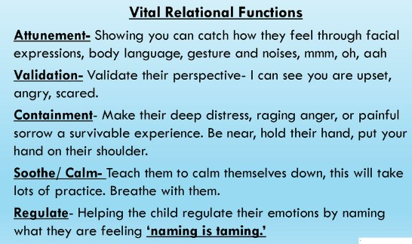
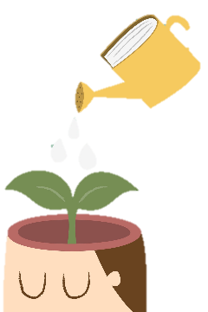
VRF’s
When things become too overwhelming for our children, we as adults, need to adopt our vital relational functions.

Slide 63
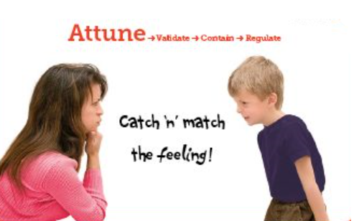
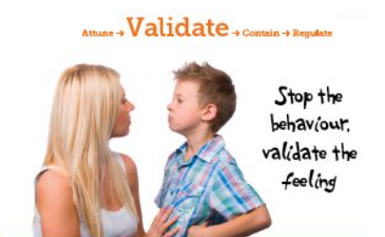
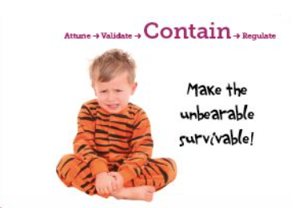
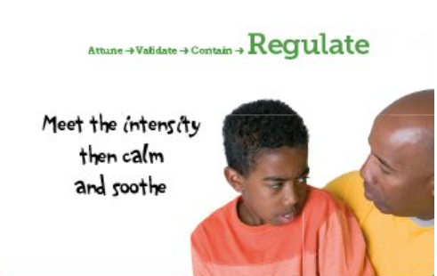

Slide 64
I can see that you’re hurting. That’s an awful feeling.
Thank you for sharing that with me. My heart hurts for you.
I know you’re really angry with me—I’m glad you are honest with me.
I’ve felt that way too.
Can I rub your back or just sit with you while you sort out these big feelings?
You’re having a really tough day. I get it.
Sometimes I feel ____ when…
I know you’re upset it didn’t work out. But you did your very best, and I’m proud of you.
That makes sense. I’d feel that way too.
It sounds like you’ve had quite a day!
I’d be disappointed too.
Friendships can be so hard! I remember struggling with these problems at playtime too.
You know, I do the same thing sometimes! It’s so hard for me to make the right choice.
I think I hurt your feelings. Can we talk about it?
It must be tempting to give up…
We’re both struggling right now, aren’t we?
Do you want to hear about my worst day at school, too?
This is hard to talk about it, isn’t it?
I don’t know what you should do, but I’m always in your corner.
It’s brave of you to talk honestly with me.

Slide 65
Source: Brene Brown on Empathy - www.youtube.com/watch?v=1Evwgu369Jw&vl=en-GB

Slide 66
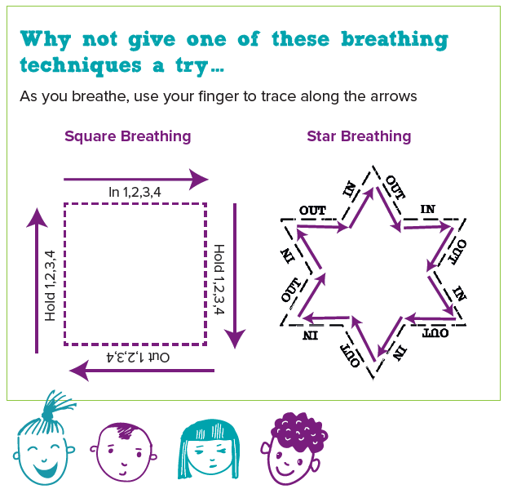
feelings
Feelings are signals in our body and it is important that we listen to them as they give us clues about what is going on around us. We need to teach our children that we all have feelings and these feelings are ok.
The following slides include strategies to help children understand their feelings…
Source: Banardos Back to School Booklet – www.barnardos.org.uk

Slide 67
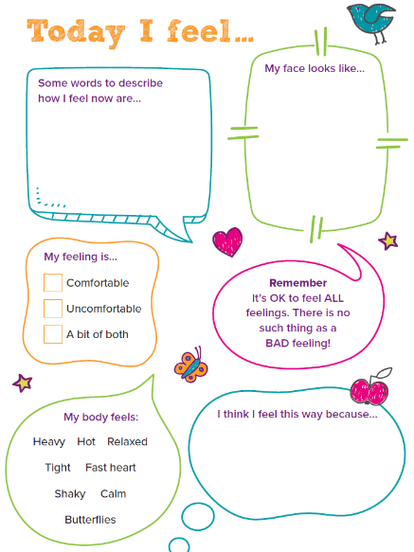
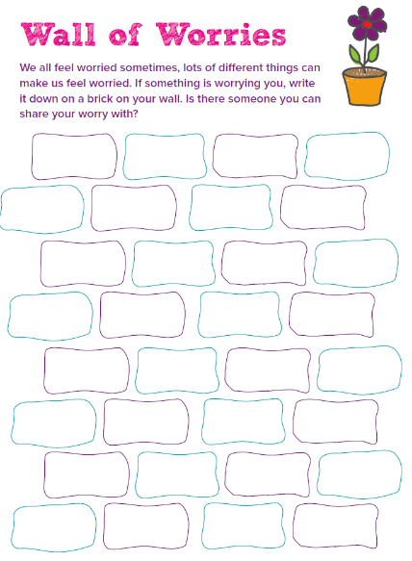
Source: Banardos Back to School Booklet – www.barnardos.org.uk

Slide 68
Source: Beacon House (Window of Tolerance) – www.beaconhouse.org.uk

Slide 69
Hints & tips

Slide 70
Thank you, not please
Really important this one! Say please too often and it may sound like you are pleading!
“Childs name…Instruction…Thank you”
(Tia refuses to put her toys away) “Tia, toys in the box, thank you.”
(Tom refuses to put his trousers on) “Tom, trousers on, thank you.”
(Mark is jumping up and down on the seat) “Mark, bottom on the seat, thank you.”

Slide 71
Take up time
Confidently give the instruction, then walk away with the expectation that your child will comply.
“I can see you’re not wanting to tidy up.”
“I wonder if you’re struggling to eat your vegetables.”
“Wow, this is really hard for you to come off the iPad.”
“Tell me if I’m wrong but I imagine you felt sad that we didn’t go for ice cream.”

Slide 72
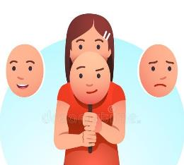
Don’t lose face
The ‘ask permission before doing’
With impulsive children it can be hard initially to stop them doing the things they want to do. In these situations, e.g. when Katie goes to run off to get something from another aisle whilst shopping, it may be worth trialing this strategy:
“Katie, hold my hand/trolley thank you. You need to use your words to tell me what you want.” When Katie uses her words, the adult says, “Yes, thank you for asking” and then, “go and look for the item.”
Initially, (where appropriate) try to say ‘yes’ as much as possible so that the child gets used to the idea that asking permission gets them what they want.
This is one step towards regulating impulses, in that it can be used to bridge the gap between saying ‘no’ outright (and then the child doing it anyway), to ‘yes’ but only with permission. If used carefully, this can prevent the adult losing face.

Slide 73
Use conditioner
Using the phrase “when…then…”
“When I have finished in this shop, then we can go home”
“When you have brushed your teeth, then we can have a story”
“When you have finished the last sentence, then you can have 30 minutes on your device”

Slide 74
Nice and nice
Child reluctant to carry out adult instruction
“Are you going to use the spoon or fork to eat your dinner?”
“Are you going to wear your pink tights or your white tights?”
“Are you going to do your homework with a pen or pencil?”
“Are you going to tidy up your toys with your monster hands or crab hands?”
Giving the child a win-win choice

Slide 75
Nice and nasty
Using a matter of fact, controlled calm voice
“Either it’s finished/tidied now, or it will have to be instead of us going to the park”
“You need to come off your ‘device’ now or you won’t be able to use it tomorrow”
“Your toys need to go away now or during TV time.”

Slide 76
Never say no
Sometimes we have to say “No” but for other times, try this… “Yes, as soon as you have…”
“I want Noura to come round and play today!” “Yes, she can come round, although not today. She can come on…”
“Can I go on the iPad?” “Yes, as soon as you’ve finished tidying away the game you have just been playing with!”
“Can I have a biscuit?” “Yes, as soon as you have finished your sandwich.”

Slide 77
Ear shotting
Speaking aloud within the child’s ear shot.
This technique can be used in a variety of ways. The adult speaks out loud to another adult or child in the room within the child’s ear shot.
“Wow, I’m so proud of Ahmed this morning helping me with the breakfast dishes. When he’s finished putting his toys away, I’m wondering if he would like to bake some cakes?”
“Dad, I think Archie can do his homework if he reads it carefully, but I’m wondering if he would like one of us to help?”
“Charlie (brother), I can see that Sarah’s cheeks are very red, I’m wondering if she’s cross you took the toy away from her?”

Slide 78
Don’t say don’t
Frame instructions positively.
We often (unintentionally) give children ideas of what to do when we are trying to get them to stop doing something.
“Walking down the stairs Ali, thank you”, rather than, “Don’t jump!”
(Waiting to go out the front door) “Remember we walk together.”
“Put that down Olivia, thank you” rather than, “don’t throw that”

Slide 79
Information directory
Look for this symbol for websites with sections suitable for children and young people. Remember to check the appropriateness of each site to your child as many are aimed at older children and teenagers.
Control + Click the link on the following slide to jump to relevant sections
Sites with this symbol have a dedicated parent helpline.

Slide 80
Parenting Children with Autism
Separation, Divorce, and Parenting apart
Parenting Anxious Children
LGBT+ Families
Parenting Children with ADHD
Information directory
Resources
General Parenting and Child Mental Health
Single Parents
Keeping Well as a Parent
Support for Families Affected by Criminal Behaviour or Domestic Abuse
Parenting Apps
Parenting Courses

Slide 81
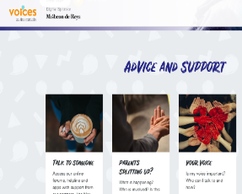
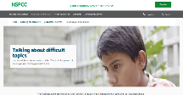
You might be interested in:
Separation, Divorce, and Parenting Apart
https://www.nspcc.org.uk/keeping-children-safe/support-for-parents/talking-about-difficult-topics/
Voices in the Middle
NSPCC
https://www.voicesinthemiddle.com
https://www.nspcc.org.uk/keeping-children-safe/support-for-parents/separation-and-divorce/
You might be interested in:
Click the pictures to explore the web pages
Family Lives
https://familylives.org.uk/advice/divorce-and-separation/shared-parenting-and-contact/what-is-shared-parenting/
Resolution
https://familylives.org.uk/advice/divorce-and-separation/shared-parenting-and-contact/advice-if-your-ex-has-different-routines-and-parenting-styles
https://resolution.org.uk/looking-for-help/parents-children-the-law/
https://resolution.org.uk/looking-for-help/parents-children-the-law/managing-life-between-two-homes/

Slide 82
You might be interested in:
Parenting Anxious Children
Young Minds
The Mental Health Foundation
https://youngminds.org.uk/find-help/for-parents/parents-guide-to-support-a-z/parents-guide-to-support-anxiety/
https://www.mentalhealth.org.uk/sites/default/files/anxious_child.pdf
https://www.mentalhealth.org.uk/our-work/children-young-people-and-families
Click the pictures to explore the web pages
Anxiety UK
CAMHS
https://www.anxietyuk.org.uk/get-help/support-for-children-young-people/
https://hampshirecamhs.nhs.uk/help/parents-carers/anxiety-professionals/
Via the CAMHS Anxiety page

Slide 83
You might be interested in:
ADHD Foundation
CAMHS
https://www.adhdfoundation.org.uk/information/parents/
https://hampshirecamhs.nhs.uk/help/parents-carers/adhd-professionals/
https://www.mentalhealth.org.uk/sites/default/files/anxious_child.pdf
Parenting Children
with ADHD
Click the pictures to explore the web pages
ADDitude
One of the only American-based sites listed so worth noting if looking for support available, but it has a good free webinars and resources section.
The UK ADHD Partnership
https://www.additudemag.com/
https://www.ukadhd.com/top-tips-for-parents!.htm

Slide 84
Parenting Children with
Autism
Click the pictures to explore the web pages
National Autistic Society
The Autism Trust
https://www.autism.org.uk/
https://www.theautismtrust.org.uk/
You might be interested in:
CAMHS
Autism Education Trust
https://hampshirecamhs.nhs.uk/help/parents-carers/autistic-spectrum-condition/
https://www.autismeducationtrust.org.uk/

Slide 85
Click the pictures to explore the web pages
More Parenting Children with
Autism
Your Autism Toolbox
Ambitious about Autism
https://yourautismtoolbox.com/
https://familylives.org.uk/advice/divorce-and-separation/shared-parenting-and-contact/what-is-shared-parenting/
Autism Little Learners
https://www.autismlittlelearners.com/

Slide 86
General Parenting & Child Mental Health
Click the pictures to explore the web pages
Anna Freud
Family Lives
https://www.annafreud.org/parents-and-carers/child-in-mind/
https://www.familylives.org.uk/
Action for Children
Citizen’s Advice
Hampshire Youth Access
https://www.actionforchildren.org.uk/in-your-area/services/online-parenting-support-for-0-5-year-olds/
https://www.citizensadvice.org.uk/family/
https://hampshireyouthaccess.org.uk/

Slide 87
Click the pictures to explore the web pages
Resources
Carol Gray Social Stories
https://carolgraysocialstories.com/carols-club/?fbclid=IwAR3tLoio6cs0vBgaF6643UlNIKpQymw996piaAnOepSfzgaJWhuFOJ2ORX8
Weekly email list with free resources
Mind Moose
https://www.mindmoose.co.uk/parents/
Big Life Journal
https://biglifejournal-uk.co.uk/

Slide 88
Keeping Well as a Parent
Click the pictures to explore the web pages
Mind
Mindful
Yoga with Adriene
https://www.mind.org.uk/information-support/drugs-and-treatments/talking-therapy-and-counselling/how-to-find-a-therapist/
https://www.mindful.org/meditation/mindfulness-getting-started/
https://www.youtube.com/user/yogawithadriene

Slide 89
Single Parents
SingleParents.org.uk
http://www.singleparents.org.uk/
Gingerbread
https://www.gingerbread.org.uk/
Click the pictures to explore the web pages

Slide 90
LGBT+
Families
FFLAG
Stonewall
https://www.fflag.org.uk/portfolio-item/gay-lesbian-parenting/
https://www.stonewall.org.uk/parenting-rights
Click the pictures to explore the web pages
Gingerbread
Mermaids UK
https://www.gingerbread.org.uk/information/lgbt-single-parents/
https://mermaidsuk.org.uk/
Supporting transgender, non-binary and gender diverse children, young people and their families.
Specific LGBT+ advice for single parents.

Slide 91
Families Affected by Criminal Behaviour or Domestic Abuse
Click the pictures to explore the web pages
The You Trust
Hampshire Domestic Abuse Services
https://theyoutrust.org.uk/
https://www.hants.gov.uk/socialcareandhealth/domesticabuse
NICCO
The Freedom Programme
The Hampton Trust
https://www.nicco.org.uk/
https://www.freedomprogramme.co.uk/
Offers an online course that can be done from your own home for both victims and perpetrators of domestic abuse.
https://www.hamptontrust.org.uk/

Slide 92
An online parenting course for parents of children of all ages from antenatal onwards.
Offered free for Hampshire and Surrey parents at the time of writing.
Apply the access code 'PARENTING’ however if you live in Surrey, you will need to use the code ACORN.
A big range of free courses run via Zoom including cooking for your family and play based courses on The Hungry Caterpillar and The Gruffalo.
Courses for Parenting or Wellbeing
Surrey Adult Learning
Our Place
https://adultlearning.surreycc.gov.uk/Page/ProspectusList?search_DESCRIPTION_operator=Contains&search_DESCRIPTION_type=String&search_DESCRIPTION_value=parenting
https://inourplace.co.uk/
Click the pictures to explore the web pages
An online CBT based course for adults to support stress, anxiety and depression, and increase wellbeing.
FEES APPLY (£30 at time of writing)
Two online training courses available: Promote Your Child’s Self-Esteem and Supporting Your Dysregulated Child
Between 1-4 hours
FEES APPLY (£10-30 at time of writing)
Be Mindful
Beacon House
https://www.bemindfulonline.com/
https://beaconhouse.org.uk/training/

Slide 93
Apps
for Parents &
Families
Available on Apple devices or Nintendo Switch.
Play your way to a calmer day!
Uses heart rate and calming activities to promote wellbeing in children.
A mood tracker and virtual community for adults.
Search the name in your app store to find the app
Mood Panda
Chill Panda
An app designed for 10-18 year olds that is based on CBT principles and also provide a mood tracker and top tips.
A science-based approach to improving happiness and wellbeing for adults.
Ollee
Currently only a web app Ollee is a ‘digital friend’ to help children reflect on how they feel.
Other Apps for family organisation and co-parenting:

