Slide 1
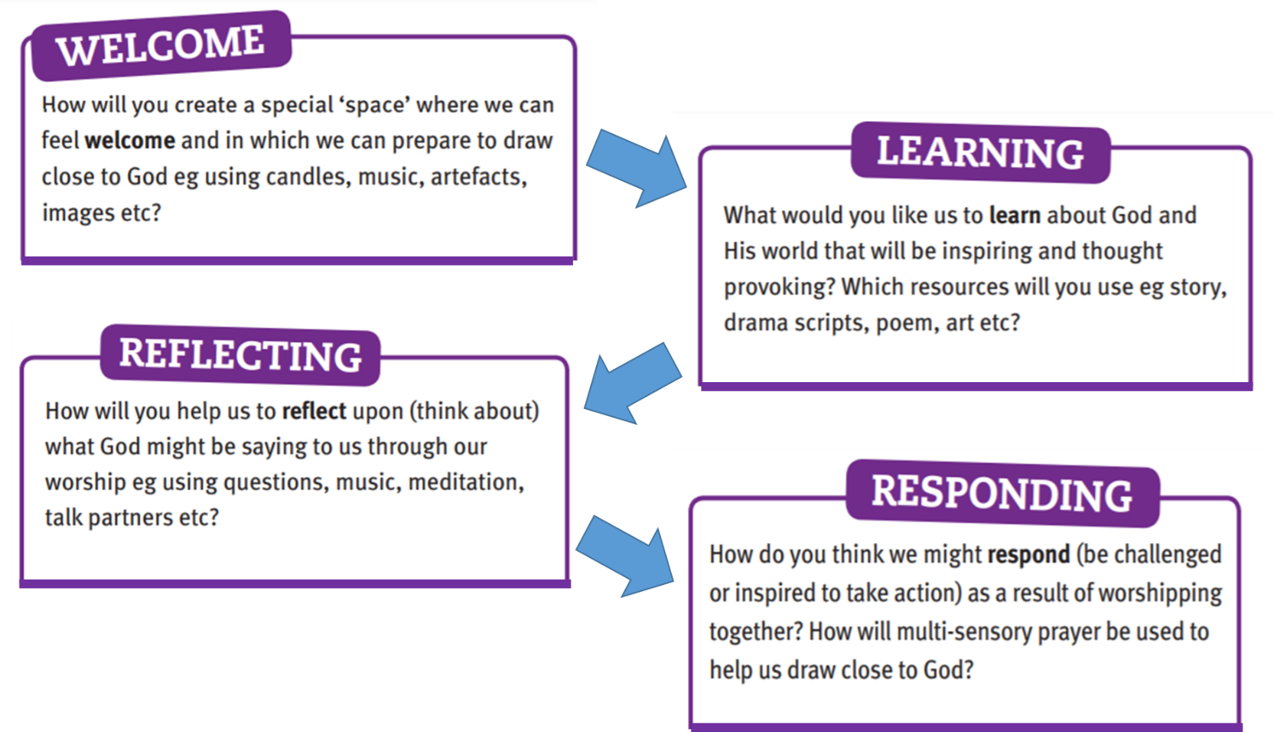


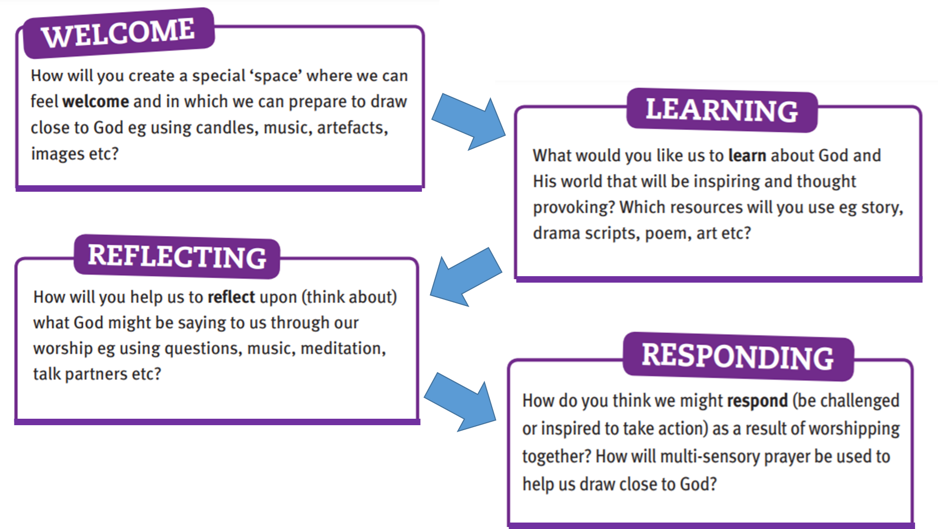
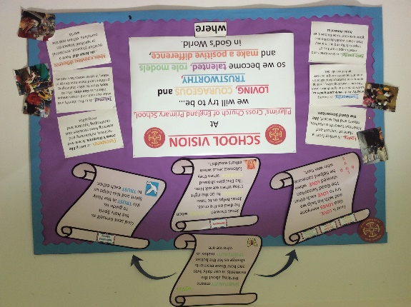
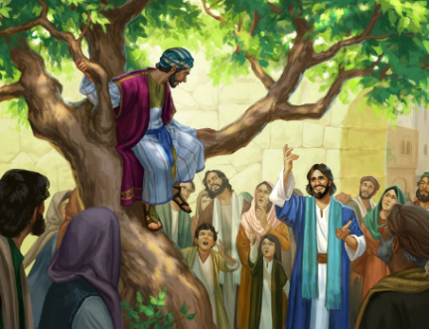
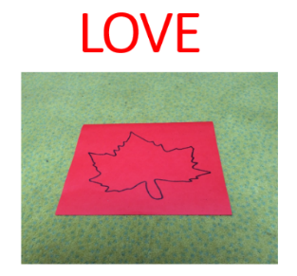

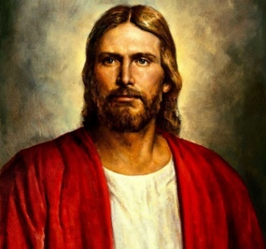

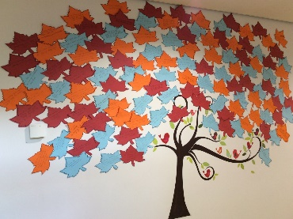

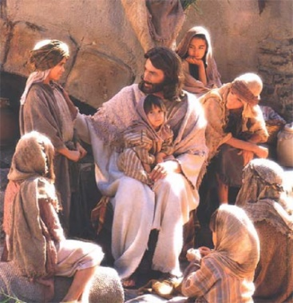

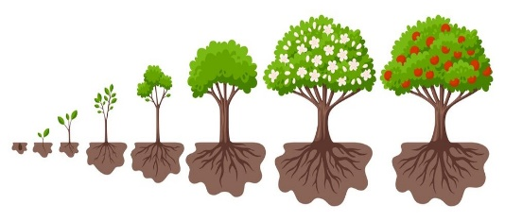
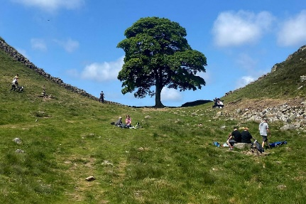
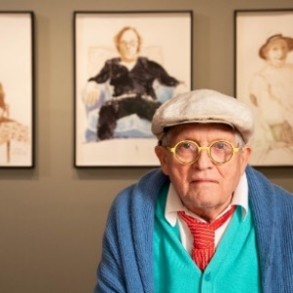



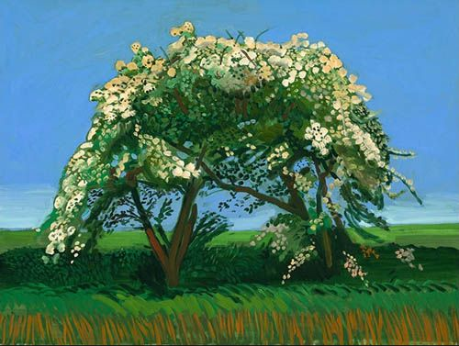
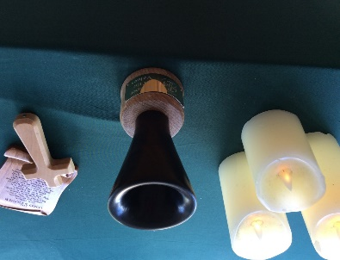
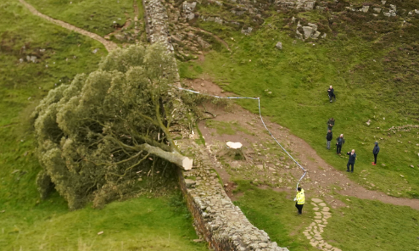
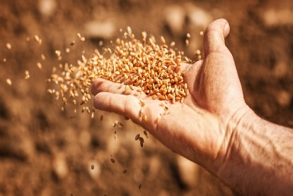

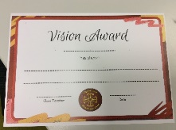
Last half term - WHOLE SCHOOL WORSHIP
Our focus was on LOVE and trees. We’ve covered so much!
Jesus said that love is…
W.W.J.D
W.W.J.S
British Values
Democracy
Rule of Law
Individual Liberty
Mutual respect
Tolerance

Slide 2
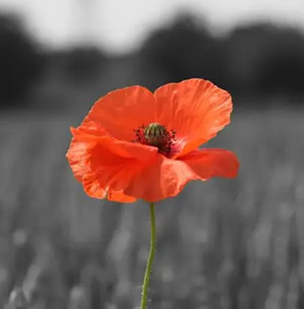
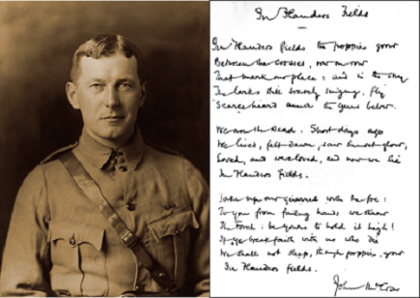
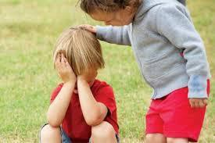
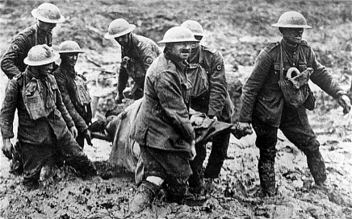
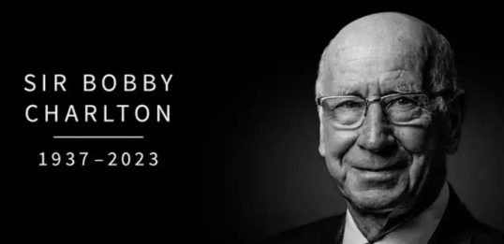
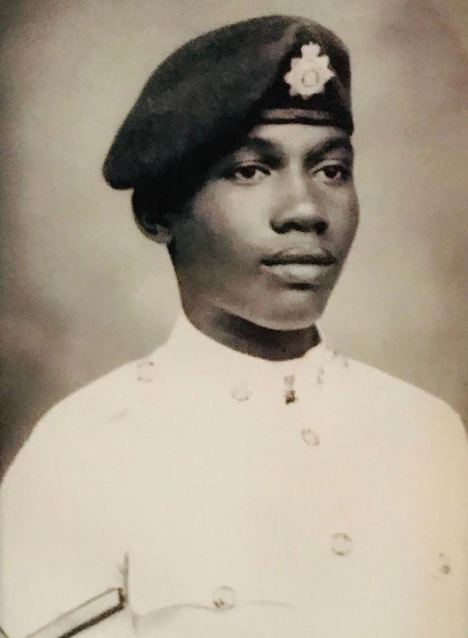

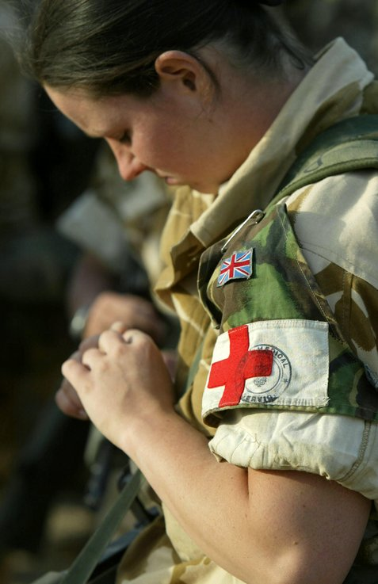
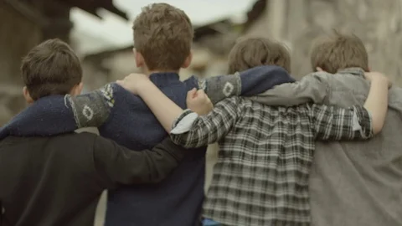

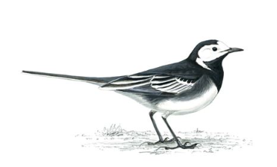

This half term - WHOLE SCHOOL WORSHIP
Our focus is on the school’s core value of COURAGE

Slide 3
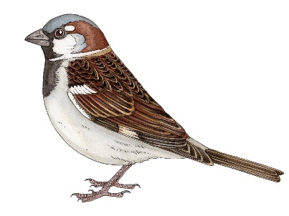
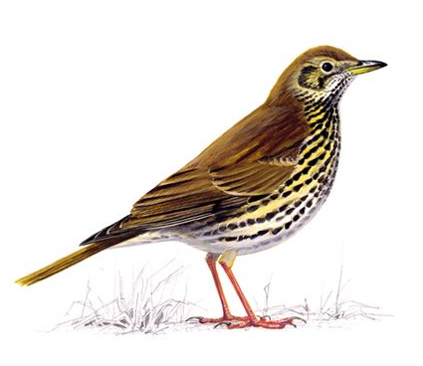
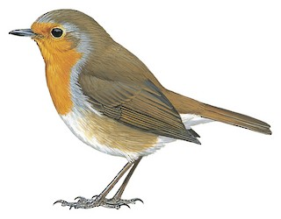

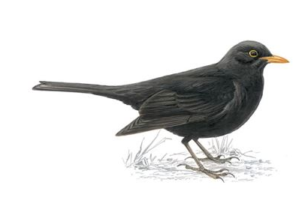
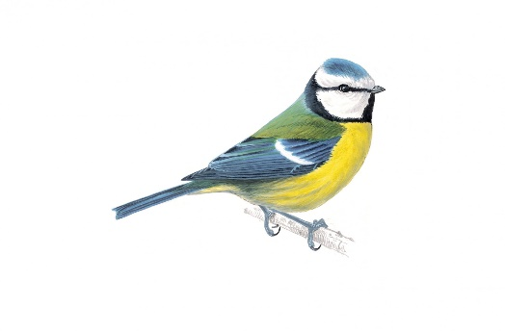
Friday 3rd November – VISION WORSHIP
Can you name these birds?

Slide 4
How did you get on?
Sparrow
Pied
Wagtail
Song Thrush
Robin
Goldfinch
Blackbird
Blue Tit

Slide 5

We light these candles to remind us… of the Father who Loves us, through the Son, who had Courage for us and the Holy Spirit, who we Trust in.
Amen.

Slide 6
School Vision
“At Pilgrims' Cross CE (A) Primary School
we are LOVING, COURAGEOUS and
TRUSTWORTHY so that we can become TALENTED ROLE MODELS and
MAKE A POSITIVE DIFFERENCE
in God's world."

Slide 7

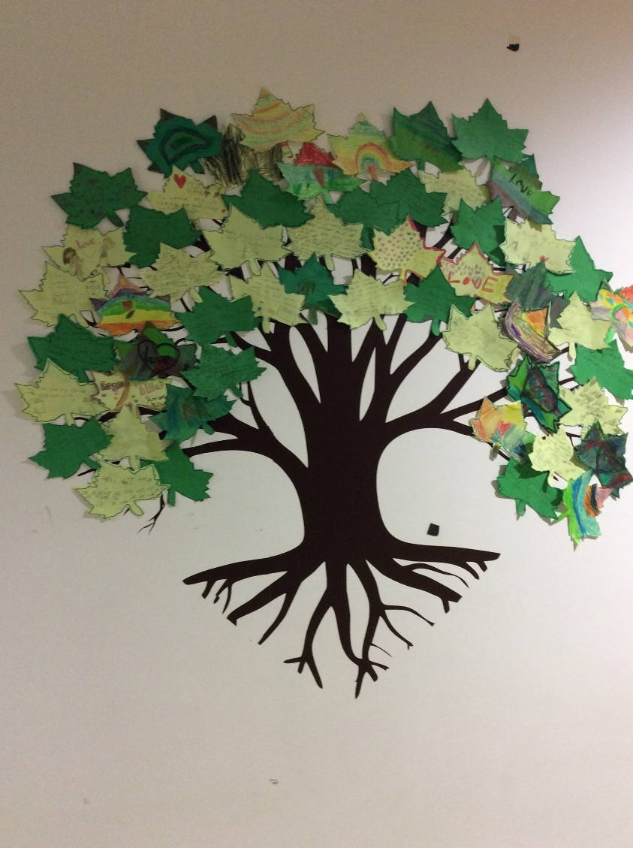

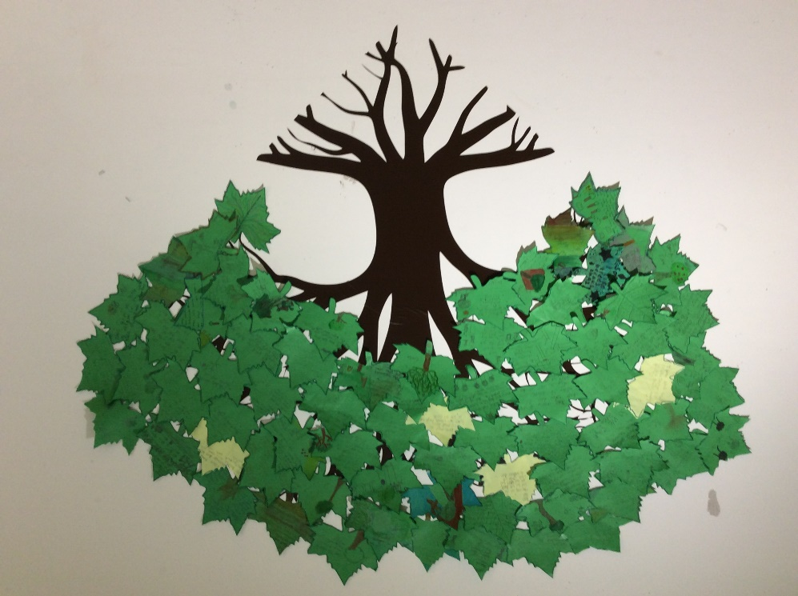



Your Spirituality Trees
Isabella’s brilliant idea has come alive!

Slide 8

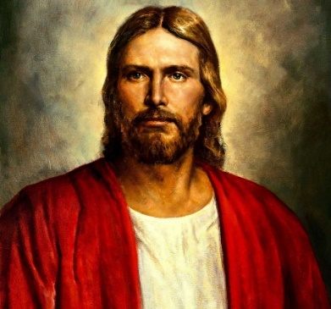

We show our School’s Values of LOVE, COURAGE and TRUST by using kind words and actions.
When we’re on green our learning brain is switched on and our learning moves forward.
W.W.J.D
Vision Award – digging that little bit deeper.

Slide 9


The Key Question this week is…
How can God/Jesus give us courage?

Slide 10



Spirituality at Pilgrims’ Cross
Self
How does God/Jesus give me courage in school?

Slide 11
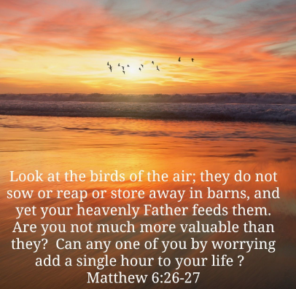

W.W.J.D
W.W.J.S
For the rest of this week – teachers and children
Showing courage through both our actions and our words.
Show courage by listening and respecting teacher’s decisions.
Be a courageous role-model in class and throughout the rest of the school.
Welcome others into my group of friends.
Have the courage to provide forgiveness and understanding to those who need it.
Being courageous by learning to think before we speak.
Trying to show love and courage to everyone all of the time.

Slide 12
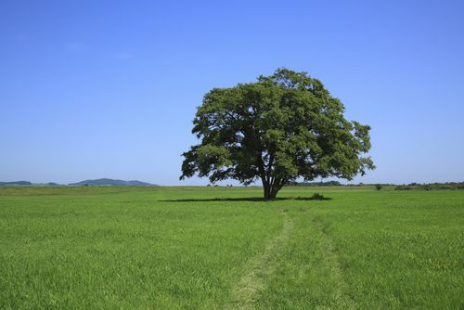

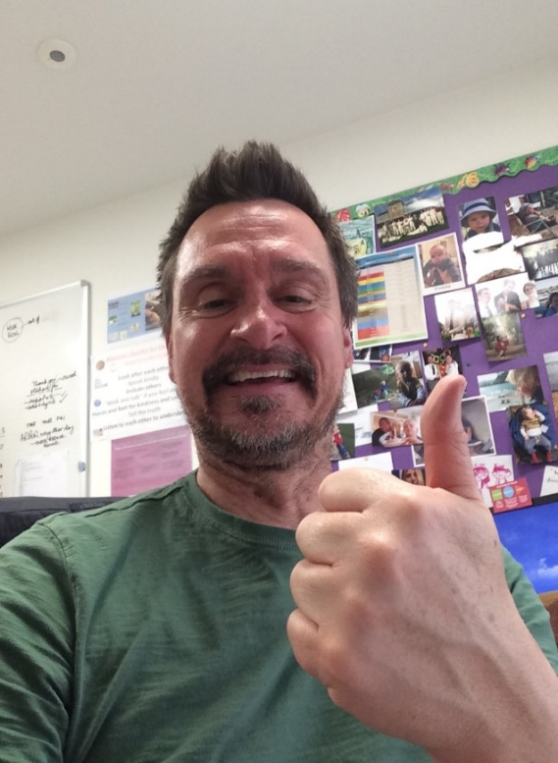
‘KEEPER OF THE VALUES’ TROPHY
The class recognised this week is…
Elm Class (Year 3)
Mr Osmond will listen and look out for…
KEEPER OF THE VALUES
For all of us this week – teachers and children
Showing courage through both our actions and our words.
Show courage by listening and respecting teacher’s decisions.
Be a courageous role-model in class and throughout the rest of the school.
Welcome others into my group of friends.
Have the courage to provide forgiveness and understanding to those who need it.
Being courageous by learning to think before we speak.
Trying to show love and courage to everyone all of the time.
W.W.J.D
W.W.J.S

Slide 13
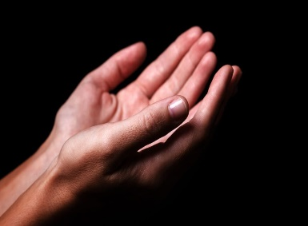

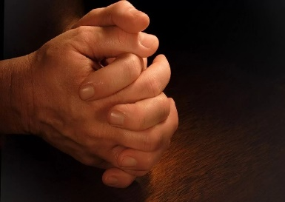
  Dear God
  Thank you for creation and the joy that it brings us.
  Help us to have the courage to do what is right, knowing that you love and care for us all.
  Amen

Slide 14
  Song: We are one!

