Slide 1
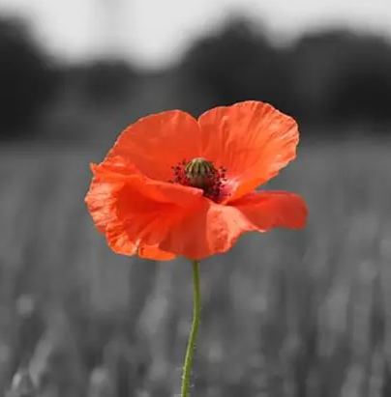
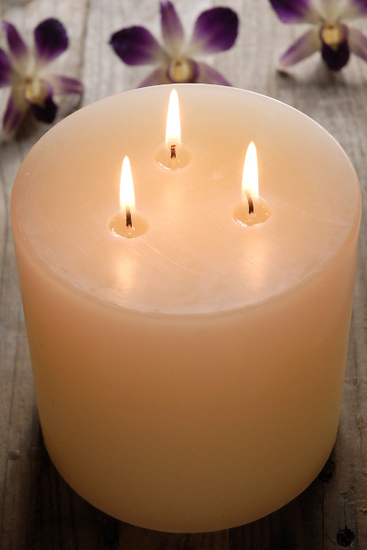
WHOLE SCHOOL WORSHIP
Sit quietly and respectfully please…thank you.

Slide 2
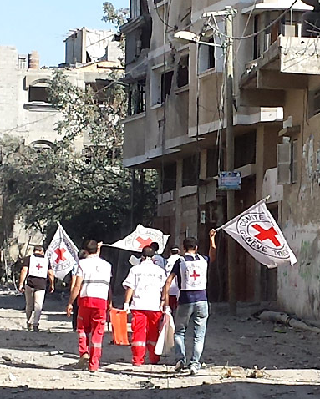
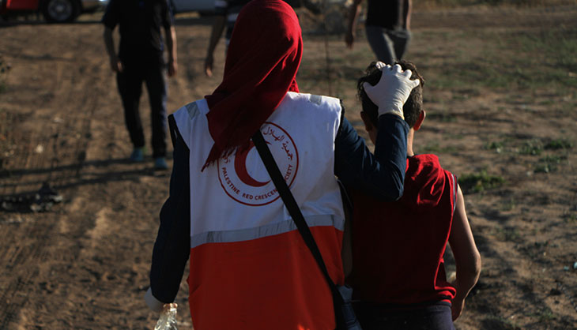
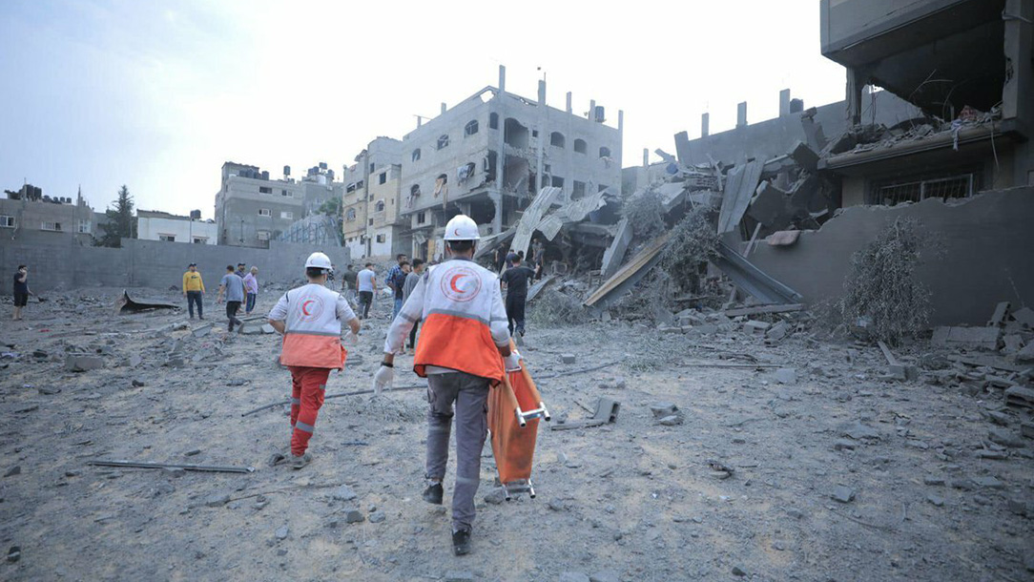
Courage
The Palestine Red Crescent Society uses a red crescent symbol.
The Red Cross, Red Crescent and Red Crystal are all symbols of protection in armed conflict.
These people aren’t part of a conflict – they’re simply there to help anyone who needs it.

Slide 3
We light these candles to remind us… of the Father who Loves us, through the Son, who had Courage for us and the Holy Spirit, who we Trust in. Amen.

Slide 4
School Vision
“At Pilgrims' Cross CE (A) Primary School
we are LOVING, COURAGEOUS and
TRUSTWORTHY so that we can become TALENTED ROLE MODELS and
MAKE A POSITIVE DIFFERENCE
in God's world."

Slide 5
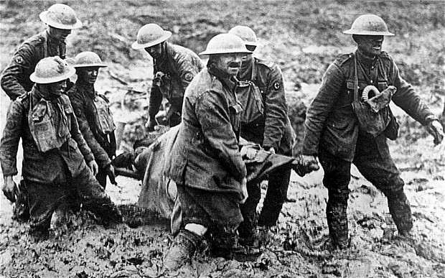
Worry
Mud
Courage
Help
Sad
Why?
Scared
The cold
Bravery
Teamwork
Saving a friend

Slide 6
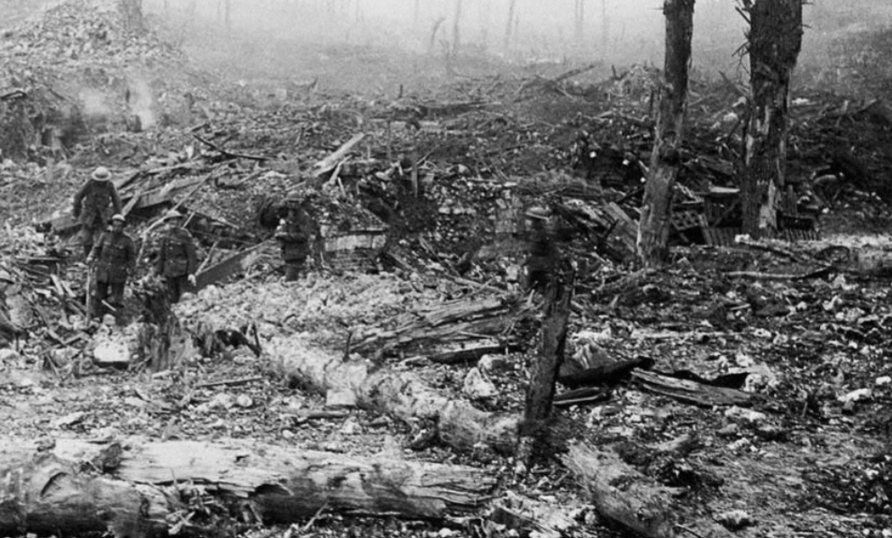
The Western Front
During WW1, much of the fighting took place in Western Europe. The countryside was blasted, bombed and fought over repeatedly. Previously beautiful landscapes turned to mud; bleak and barren scenes where little or nothing could grow.

Slide 7
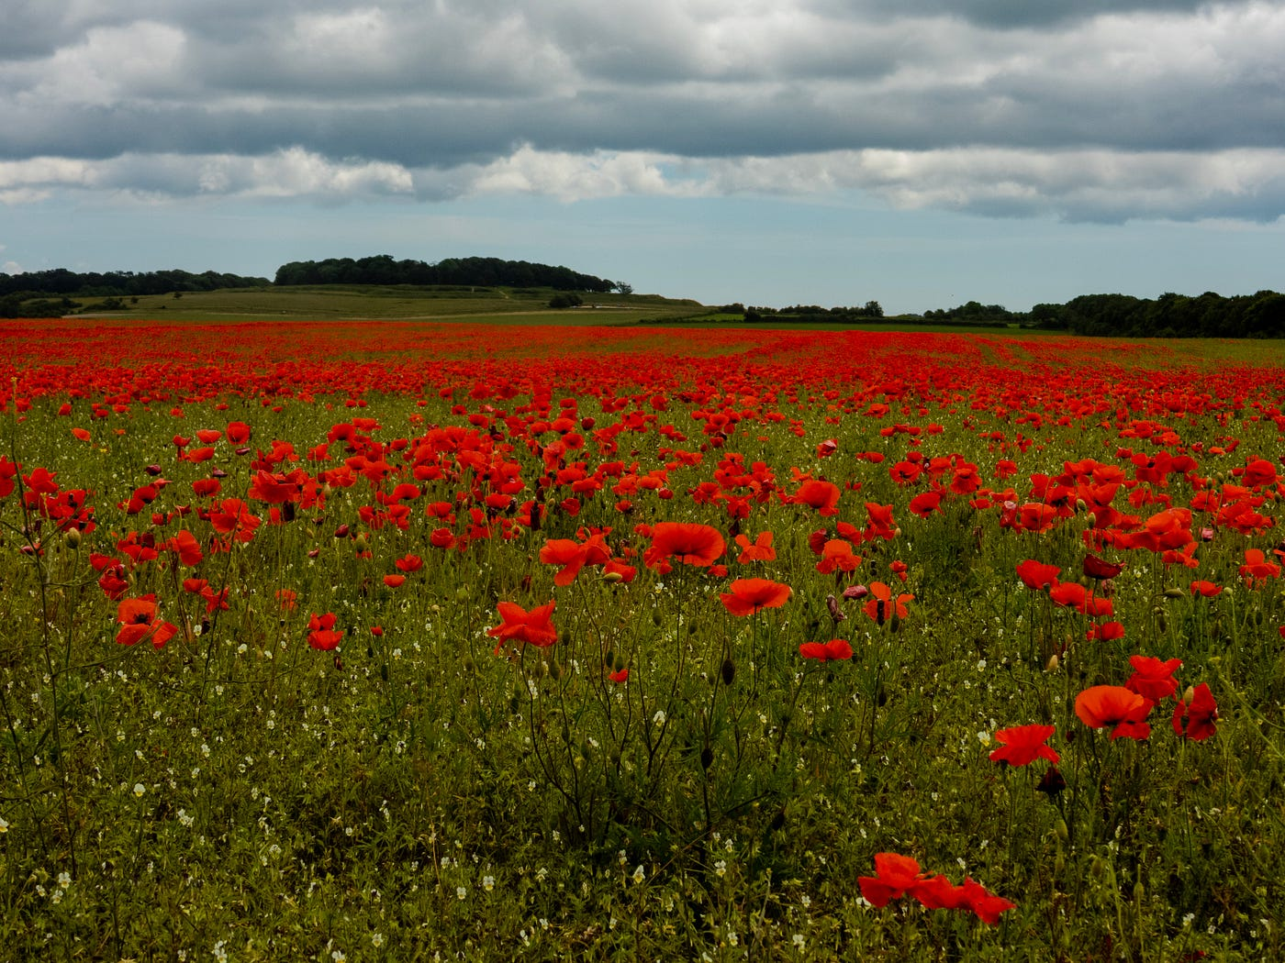
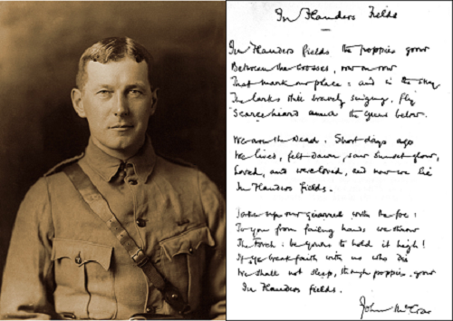
Fields of Poppies
There was a notable and striking exception to the bleakness - the bright red Flanders poppies. These resilient flowers flourished in the middle of so much chaos and destruction, growing in the thousands upon thousands.

Slide 9
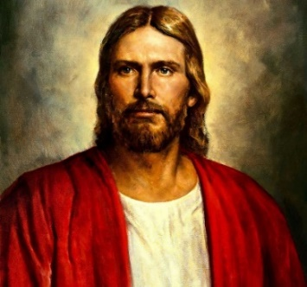

Slide 10
The Key Question this week is…
When do you need to be courageous?
Physical Courage – keep going, even when you feel tired.
Social Courage – be yourself and share your ideas.
Moral Courage – trying to do the right thing all of the time.
Emotional Courage – sharing and showing your feelings.
Intellectual Courage – making mistakes, learning from them and trying new things.
Spiritual Courage – connecting with others, nature and your faith.

Slide 11
W.W.J.D
W.W.J.S
For the rest of this week – teachers and children
Showing courage through both our actions and our words.
Show courage by listening and respecting teacher’s decisions.
Be a courageous role-model in class and throughout the rest of the school.
Welcome others into my group of friends.
Have the courage to provide forgiveness and understanding to those who need it.
Being courageous by learning to think before we speak.
Trying to show love and courage to everyone all of the time.

Slide 12
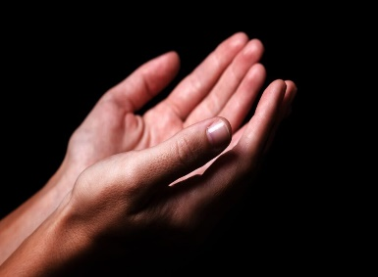
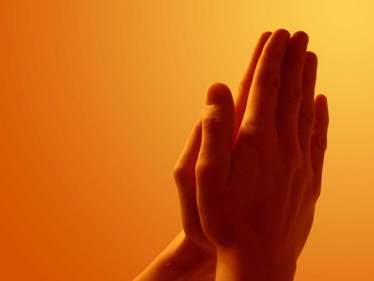
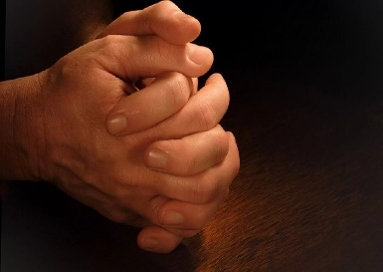
Dear God
Help us to have the courage to do what is right, knowing that you are there to love and protect us.
Amen

