Slide 1
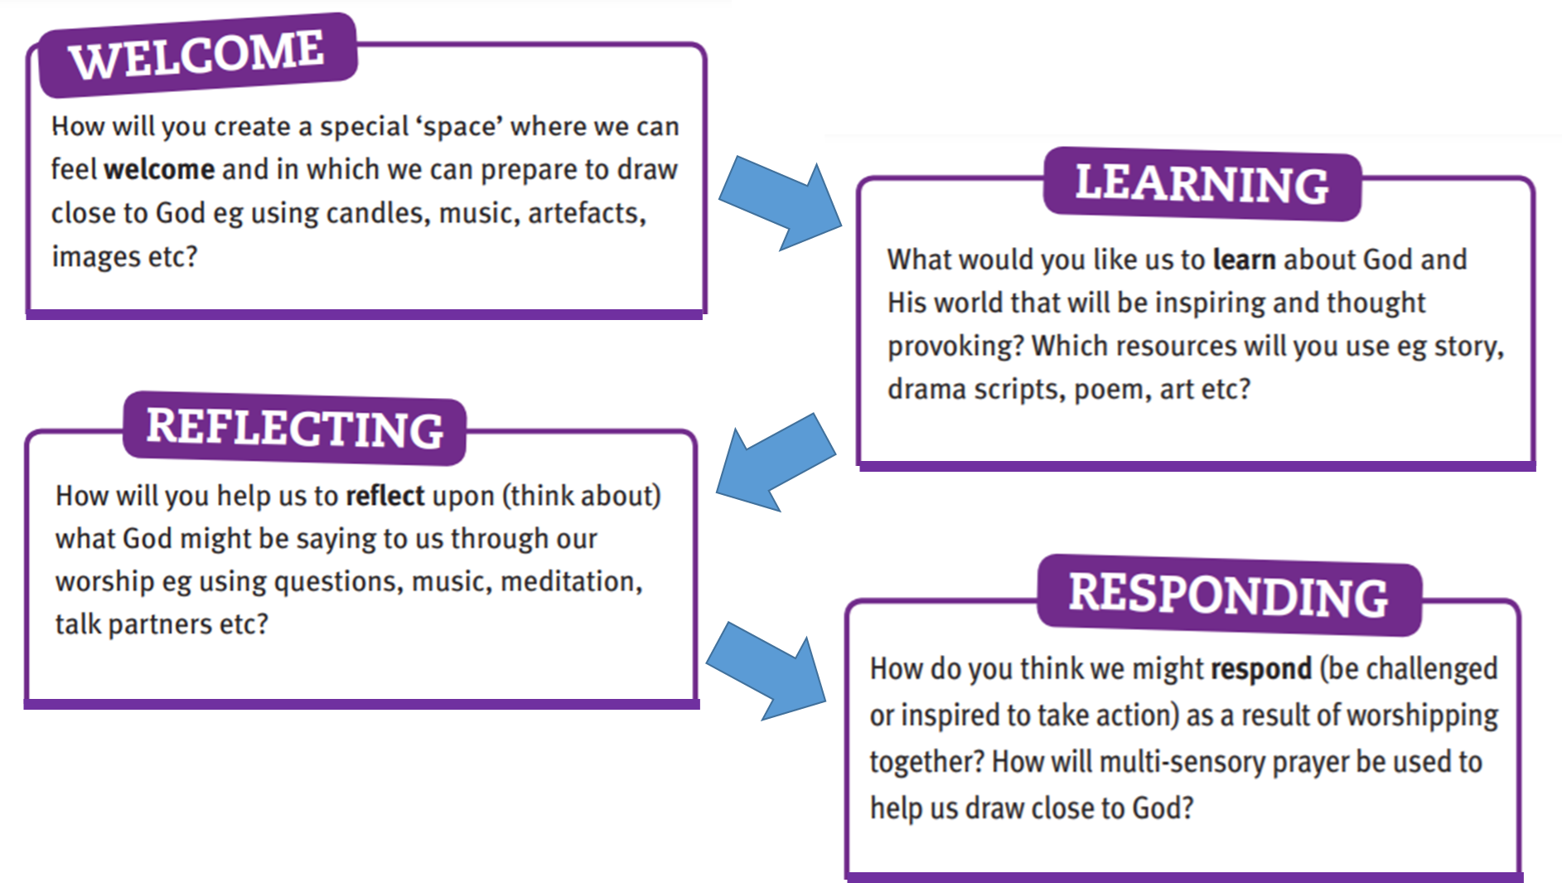

Monday 3rd June – WHOLE SCHOOL WORSHIP
WHOLE SCHOOL WORSHIP
Showing TRUST in one another
We shall walk into the hall quietly and respectfully.
We wait patiently
We listen carefully.
We speak honestly.
When an arm is raised we shall complete our conversations.
We sing joyfully.
We pray lovingly.
We lead out sensibly.

Slide 2

School Vision
“At Pilgrims' Cross CE (A) Primary School
we are… LOVING, COURAGEOUS and
TRUSTWORTHY
so that we can become talented role-models and make a positive difference in God's world."

Slide 3
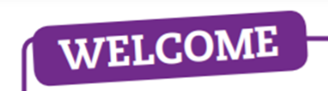
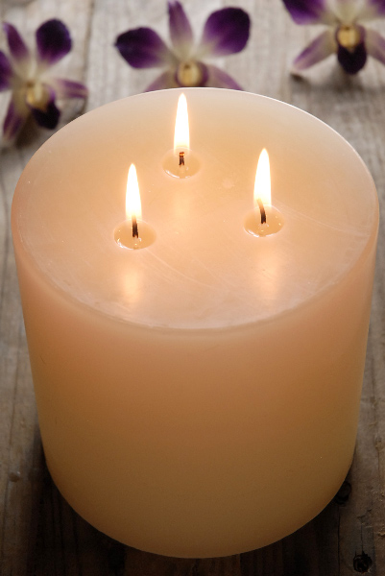
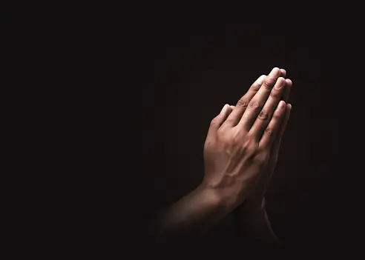
We light these candles to remind us… of the Father who Loves us, through the Son, who had Courage for us and the Holy Spirit, who we Trust in.
Amen.

Slide 5
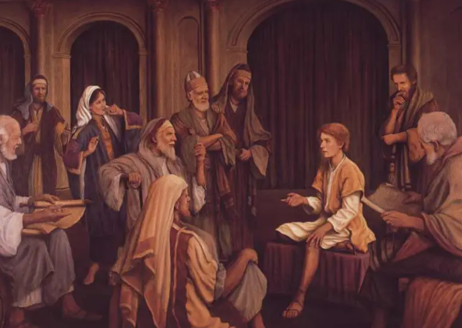
Say what you see!

Slide 6
Priests
truth
In church
Jesus
listening
company
wonder
wonder
Temple
teaching
questions
attention
message
group
boy

Slide 7

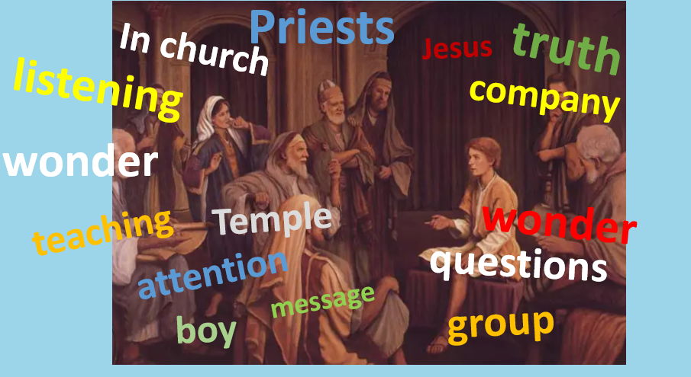
Luke 2: 41-52

Slide 8

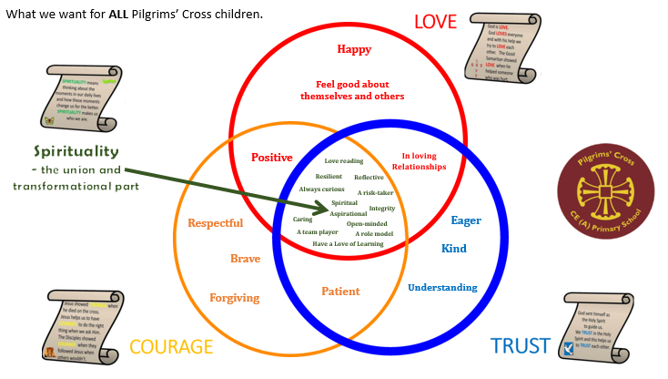
The key question this week is…
Who do you trust and why?

Slide 9

British Values
Democracy
Rule of Law
Individual Liberty
Mutual respect
Tolerance

Slide 10

What we DON’T want to see or hear!
Rude and unkind words that hurt
Deliberately leaving people out
Only having my way
Broken friendships
Being uncaring
Being negative
Gossiping
Physical behaviour that hurts
Disrespecting adults

Slide 11

What we DO want to see and hear!
Kind words, kind words, kind words
Forgiveness
Understanding
Loving friendships
Goodness
Positivity
Celebration of Self and others
Mutual Respect
Looking out for others needs

Slide 12
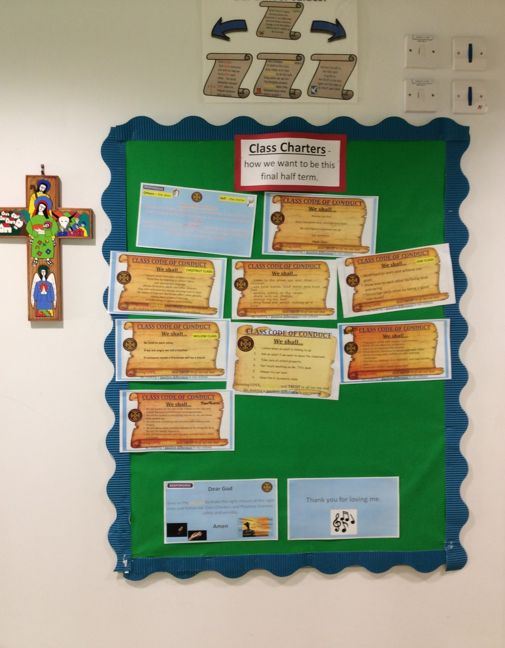

Slide 13

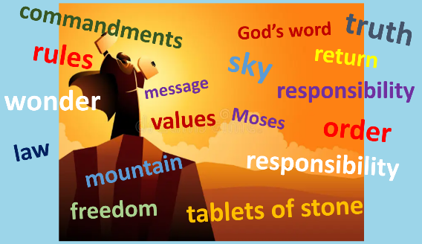






Playtime Charter for us ALL
Love
Courage
Trust
Look after each other.
Speak kindly.
Include others.
“Walk and talk” if you feel angry.
Hands and feet for kindness and safe games.
Tell the truth.
Listen to each other to understand.

Slide 14







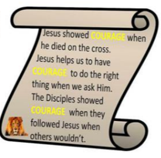



What we want for ALL Pilgrims’ Cross children.
Happy
Feel good about themselves and others
Understanding
Spirituality
- the union and
transformational part
Positive
In loving
Relationships
A love of reading
Resilient
Reflective
Always curious
A risk-taker
Kind
Spiritual
Integrity
Caring
Aspirational
Open-minded
A team player
A role model
Have a Love of Learning
Eager
Patient
Brave
Forgiving
Respectful
Strong

Slide 15
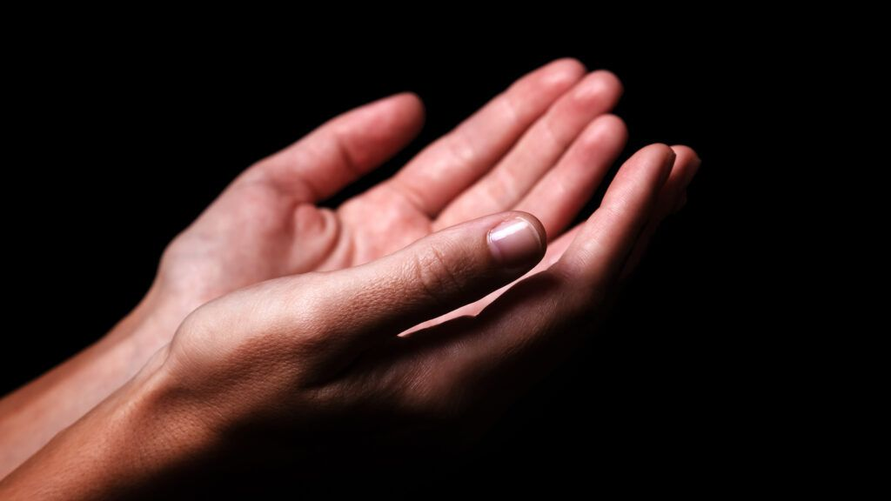
Dear God
Help us to trust one another, knowing that our friends, family and adults in school are always there for us.
Amen

Slide 16

As One.

