Slide 1
Tuesday 11th June – CLASS WORSHIP

Slide 3
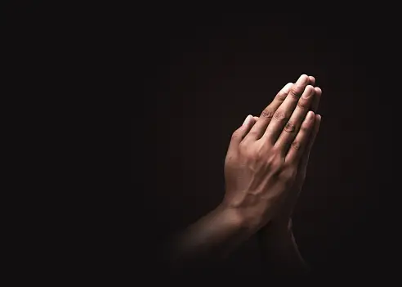
We light these candles to remind us… of the Father who Loves us, through the Son, who had Courage for us and the Holy Spirit, who we Trust in. Amen.

Slide 4
School Vision
“At Pilgrims' Cross CE (A) Primary School
we are… LOVING, COURAGEOUS and
TRUSTWORTHY
so that we can become talented role-models and make a positive difference in God's world."

Slide 5
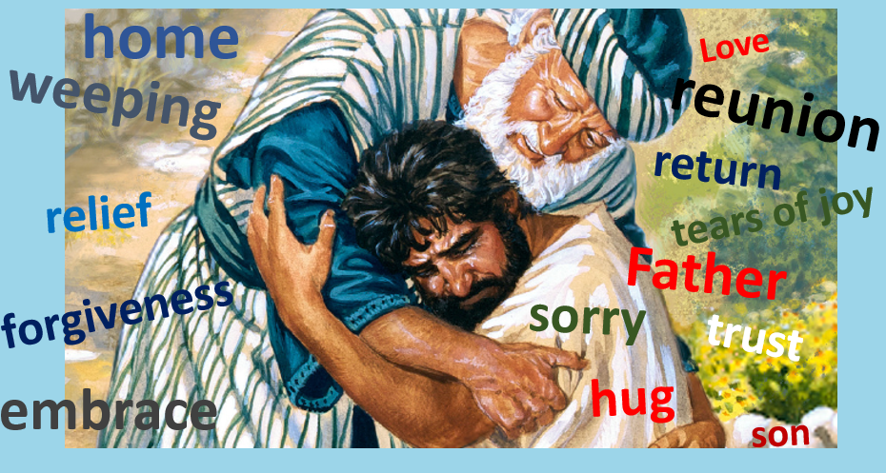
Remember this…
Now let’s read about this event in The Bible.

Slide 6
The prodigal son returns – Luke 15 verses 18-24
¹⁸ I will arise, thought the son, and go to my father, and I will say to him, “Father, I have sinned against heaven and before you. ¹⁹ I am no longer worthy to be called your son. Treat me as one of your hired servants.”’ ²⁰ And he arose and came to his father. But while he was still a long way off, his father saw him and felt compassion, and ran and embraced him and kissed him. ²¹ And the son said to him, ‘Father, I have sinned against heaven and before you. I am no longer worthy to be called your son.’ ²² But the father said to his servants, ‘Bring quickly the best robe, and put it on him, and put a ring on his hand, and shoes on his feet. ²³ And bring the fattened calf and kill it, and let us eat and celebrate. ²⁴ For this my son was dead, and is alive again; he was lost, and is found.’ And they began to celebrate.

Slide 7
The prodigal son returns – Luke 15 verses 18-24
Questions to discuss and consider.
Was the father right to take his son back?
How would you have reacted if you had seen the son return?
Why do you think the father celebrated his son’s return?
What is compassion?
Where does TRUST come in this story?

Slide 8
British Values
Democracy
Rule of Law
Individual Liberty
Mutual respect
Tolerance

Slide 9
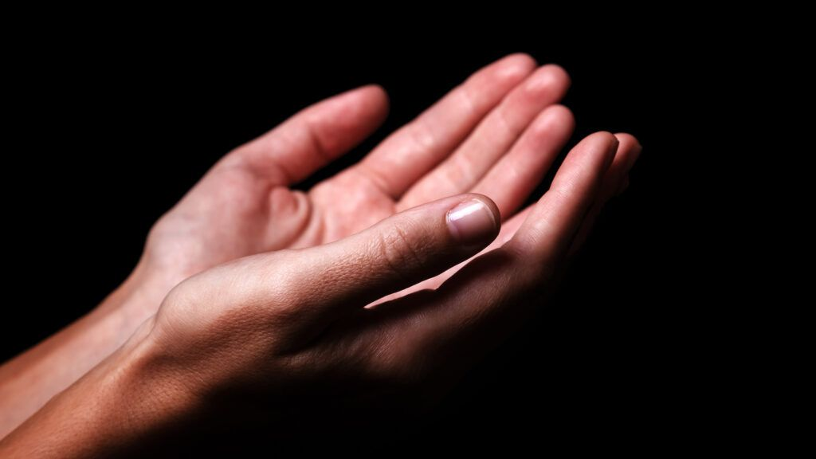
Dear God
Thank you for the father in the story of the prodigal son, who trusted his son would return and celebrated their reunion.
Help us to be forgiving of one another.
Amen

Slide 10
Cause to be grateful.

